Slide 1


Partnering to Eliminate Cervical Cancer in Alabama

Slide 2
Eliminating Cervical Cancer:
What Can You Do?
Join Operation WIPE OUT
Assess Your Region’s Needs
Become an ABCCEDP Provider
Become an Advocate in Your Region

Slide 3
Eliminating Cervical Cancer is Possible
HPV Vaccination
Cervical Cancer Screening
Appropriate Follow-up
Timely Treatment

Slide 4
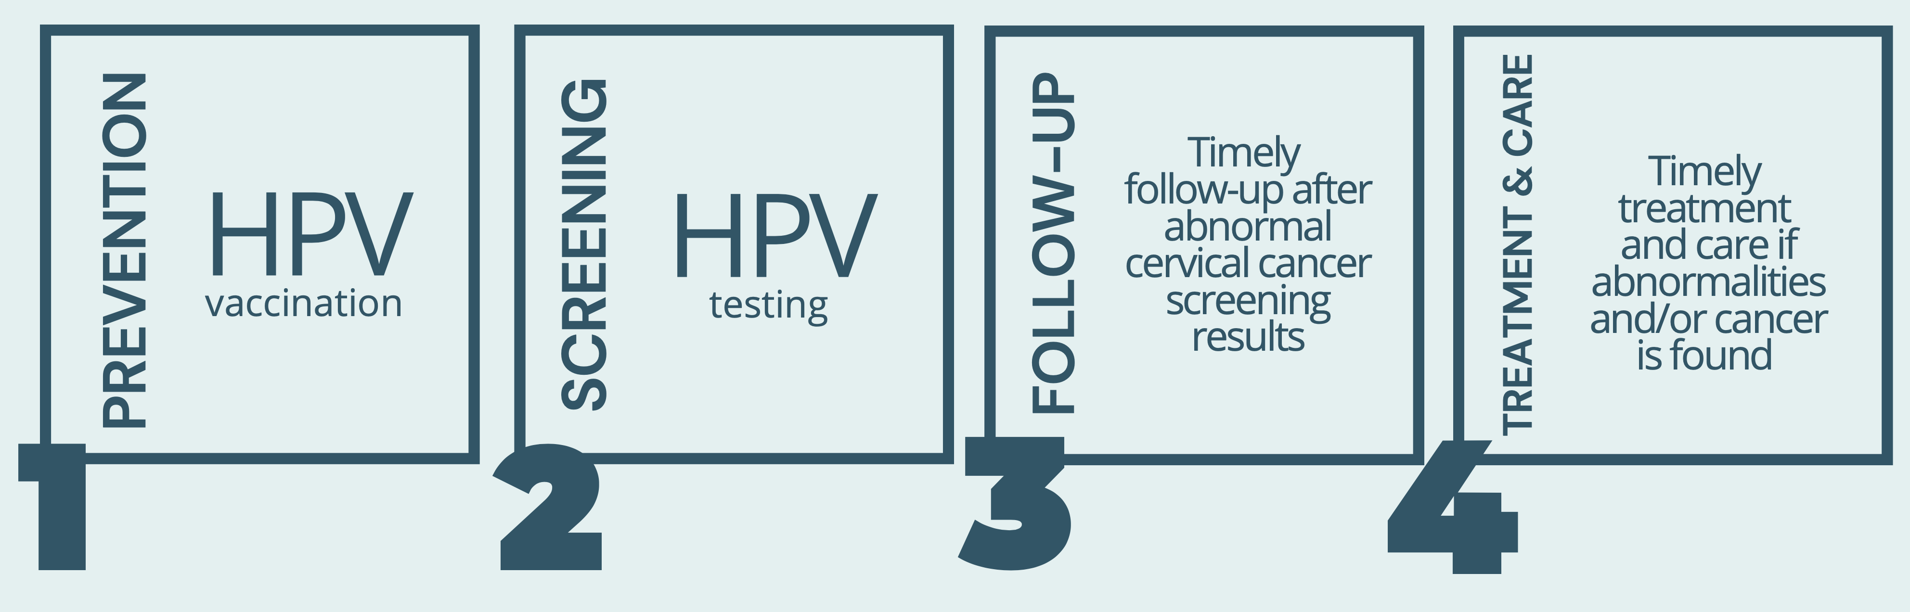
World Health Organization
Global call to Action to Eliminate Cervical Cancer
4 Key Strategies:

Slide 5
What Is Operation Wipe Out?
Statewide effort to eliminate cervical cancer as a public health problem in Alabama through:
  Increased HPV vaccination
  Increased cancer screening through regular HPV/Pap testing
  Increased appropriate follow-up/treatment for women who have abnormal test results
An Umbrella that captures previous, ongoing, and new efforts by state, academic, non-profit, and individual efforts to reduce cervical cancer mortality in Alabama
A Call to Action to every community member to take steps to Wipe Out Cervical Cancer in our lifetime

Slide 6

Action Plan to Eliminate Cervical Cancer
Rationale
Summit Structure & Organization
HPV Vaccination / Screening/ Follow-Up
  Barriers/Facilitators/Solutions Table w/# votes
  HPV Data Baseline and Goal
  Strategic Action/Potential Responsibilities & Partners Table
Acknowledgements
Appendices
  Overview of Basics
  ABCCEDP
  References
  Research Findings Within Last 5 Years
  Evaluation Results
Notes:
Overall, based on the evaluation results, discussions, and identified solutions, this event was successful in executing the intended aim. As evidenced by the evaluation averages, primary healthcare providers and public health leaders felt they engaged in informed, purposeful discussions that were relevant to their practice. They felt that attendees were actively involved. Finally, they felt encouraged to engage in discussions to identify barriers, facilitators, and solutions to increase the uptake of HPV vaccination, cervical cancer screening, and adherence to follow-up for abnormal results and treatment. Notably, participants indicated they left the meeting with a clear understanding of expectations—to increase HPV vaccination uptake, cervical cancer screening, and adherence to follow-up in the event of abnormal results associated with cervical cancer screening. This event was the first of its kind and provided the roadmap for a statewide action plan.

Slide 7
Operation WIPE OUT
Cervical Cancer Alabama
Alabama is the 1st State in the Nation to Announce a Statewide Effort to Eliminate Cervical Cancer in Alabama
May 8, 2023

Slide 8
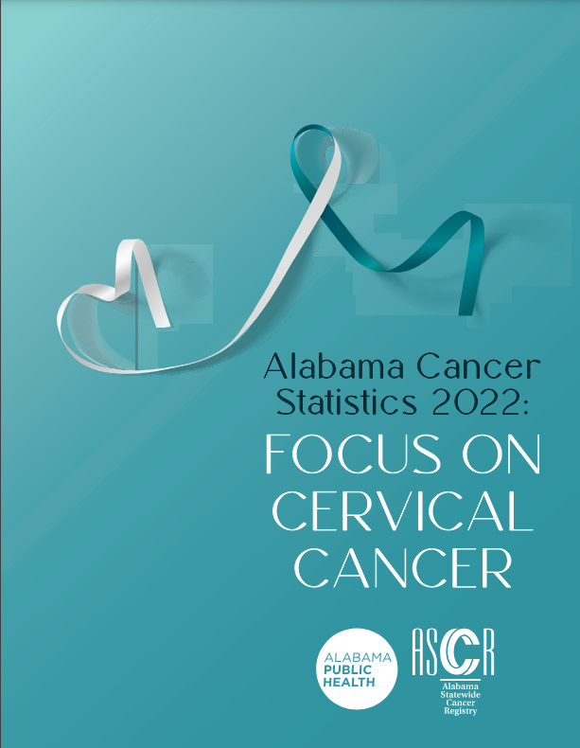
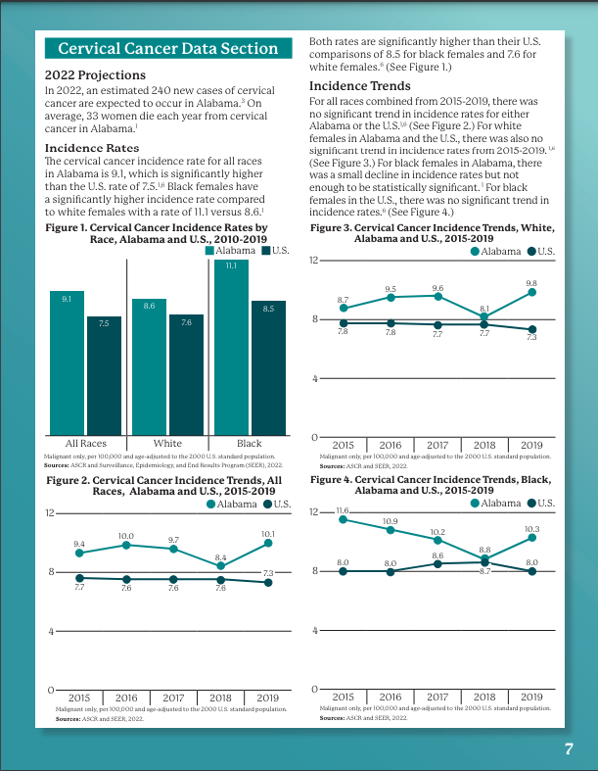
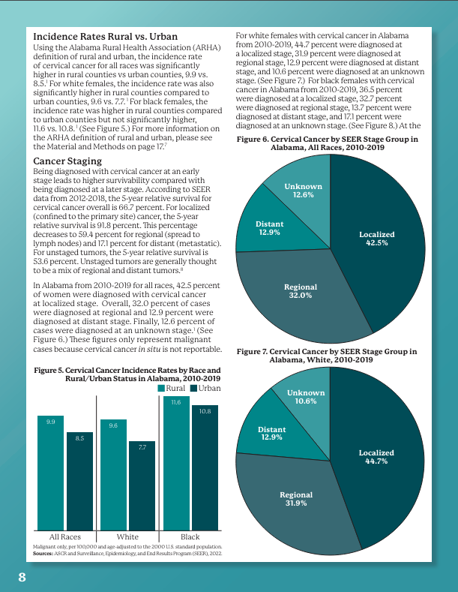
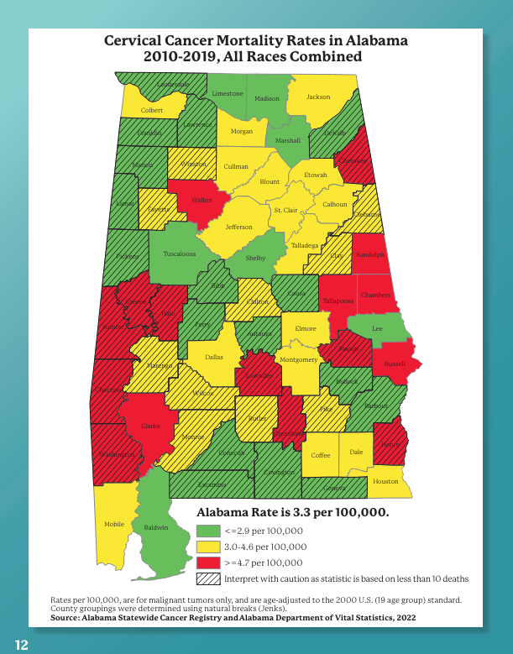
Al Cancer Statistics 2022:
Focus on Cervical Cancer
4th highest mortality in the nation (CDC 2021)
Black women higher incidence/mortality than nation
HPV vaccination lower than the nation (47% vs 54%)
Incidence rates/trends/rural vs. urban
Staging
Mortality rates/trends/rural vs. urban
Maps of incidence & mortality by county
Breast and Cervical Cancer Program
Screening Recommendations
Notes:
Data-Driven Decisions
Credibility

Slide 9
WIPE OUT Partners
UAB Department of Obstetrics and Gynecology
O’Neal Comprehensive Cancer Center
University of South Alabama Mitchell Cancer Institute
TogetHER for Health
Alabama Department of Public Health
Rotary Club of LaFayette
Rotary Club of Birmingham
American Cancer Society
Huntsville Hospital Hlth System
Auburn University
Quality of Life Health Services
Russell Medical Cancer Center
Circle of Care
Chambers County School District
VAX 2 STOP CANCER
Tuskegee University
Alabama Comprehensive Cancer Control Coalition

Slide 10
Engaging Additional Partners
Press Conference Generated a lot of State and National Interest
Roundtable Participation (Cervical, HPV, Southeastern HPV)
Other States Interest
HPV related Conferences Interest
Clinician Interest
Media Interest
Documentary Interest

Slide 11
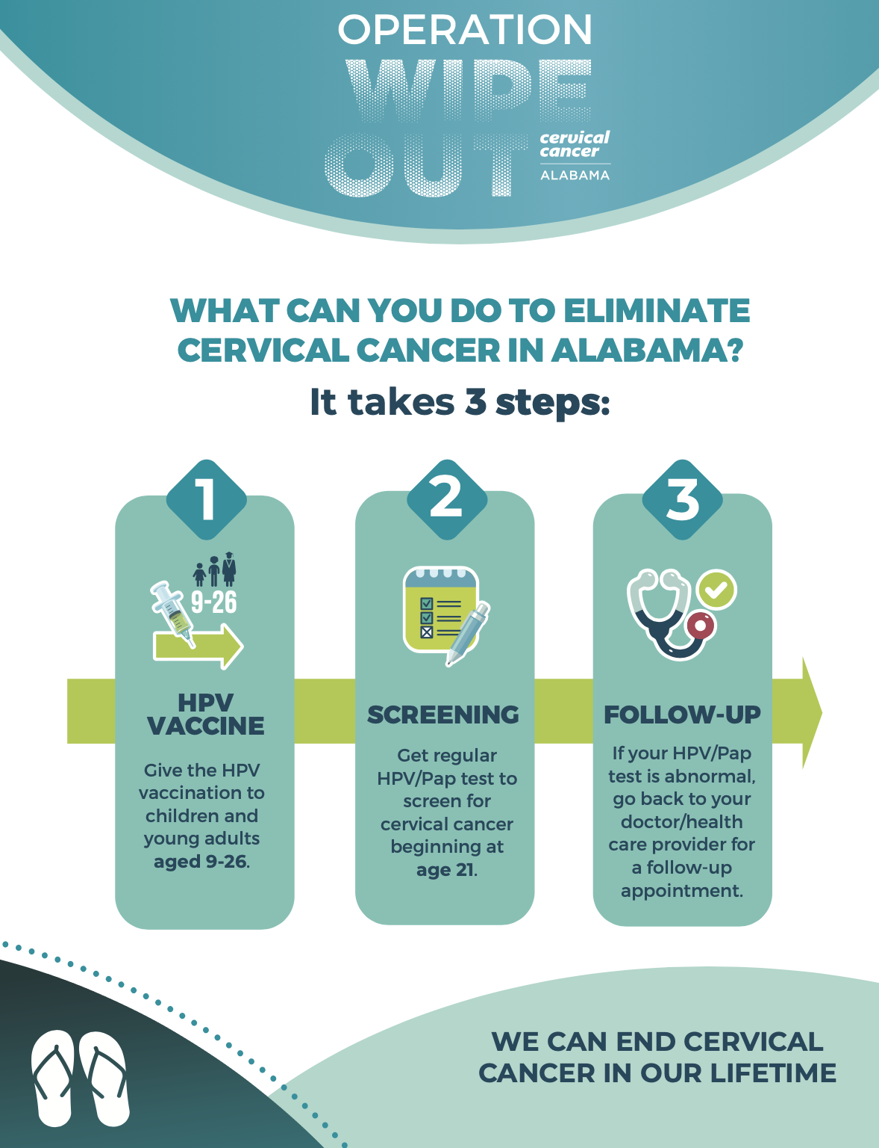
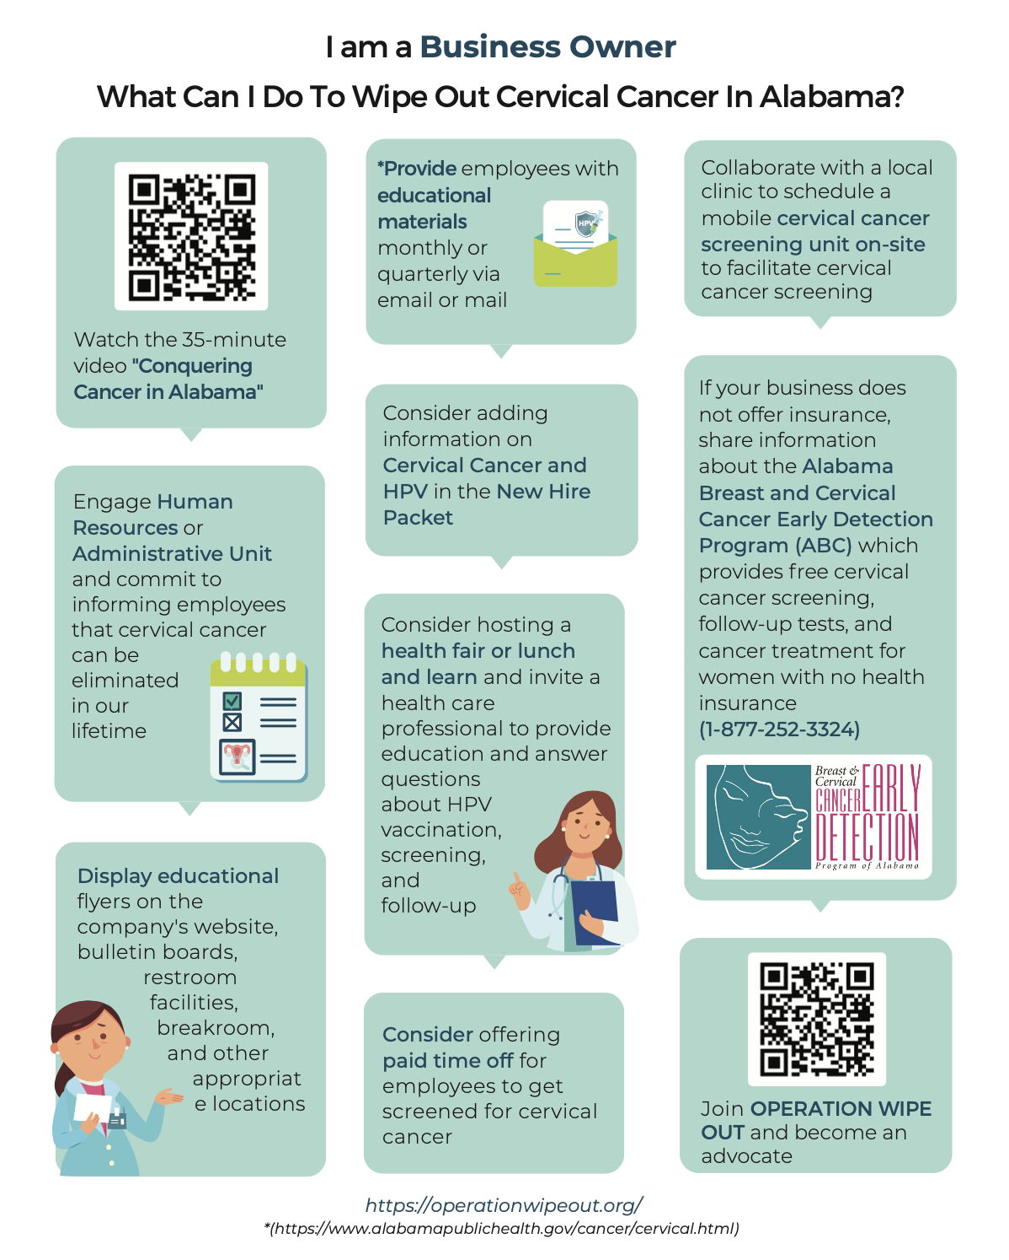
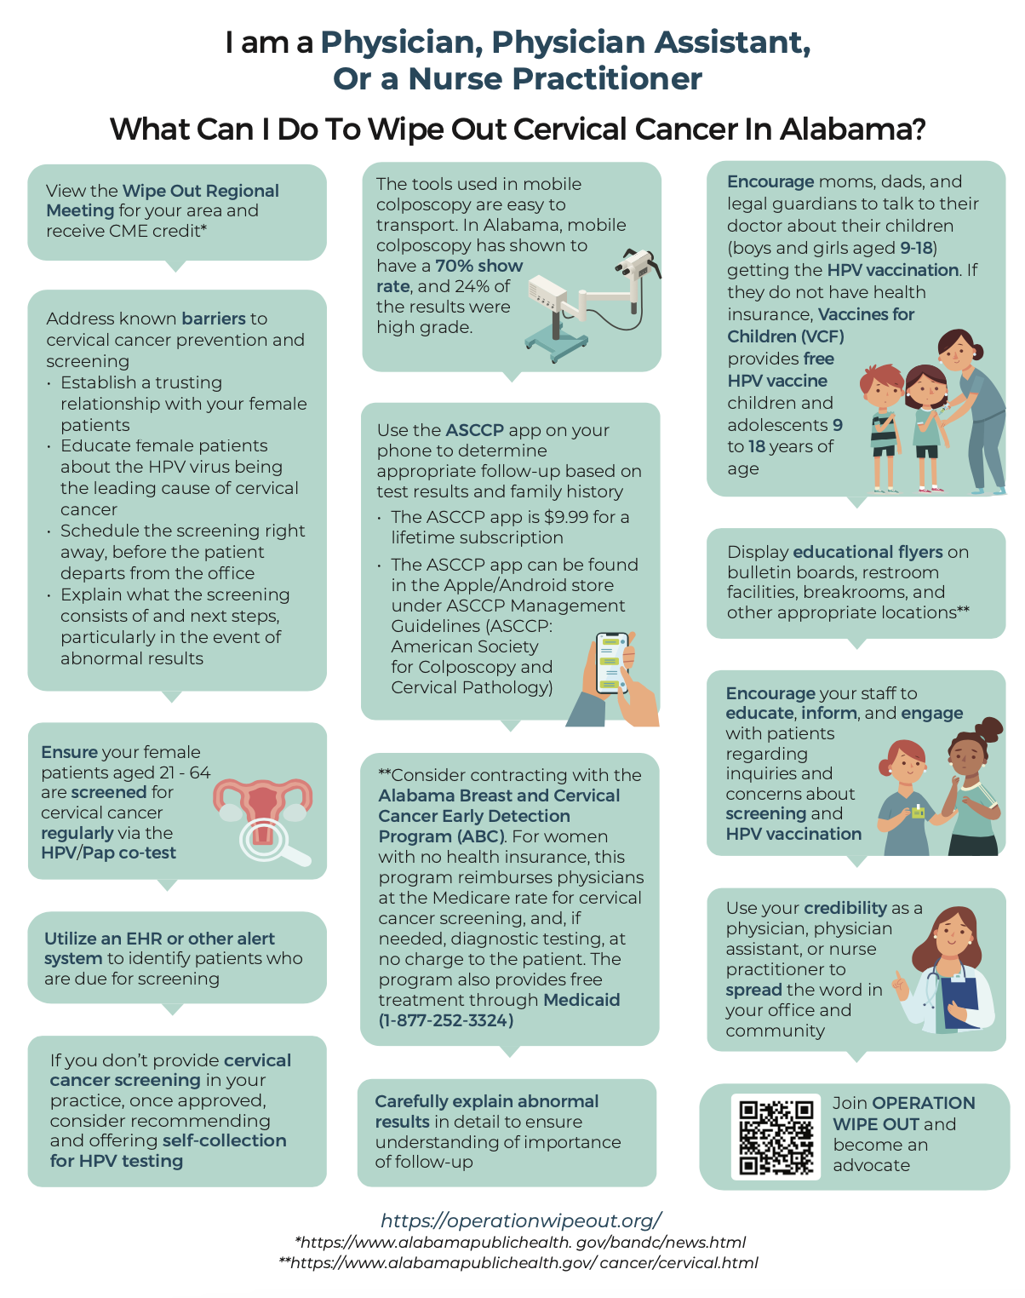
Engaging Additional Partners

Slide 12
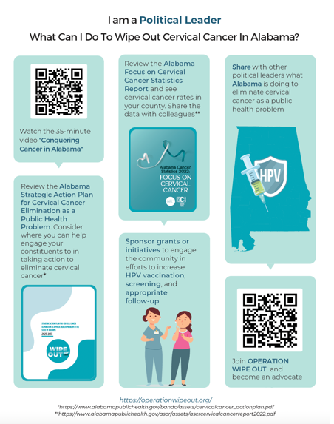
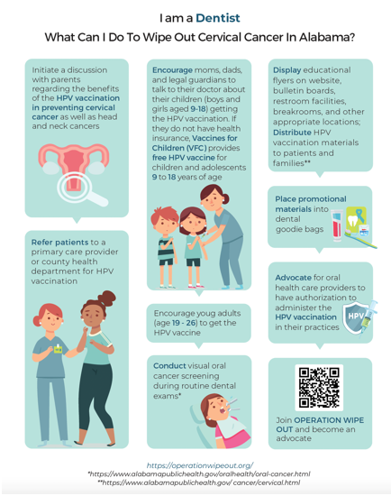
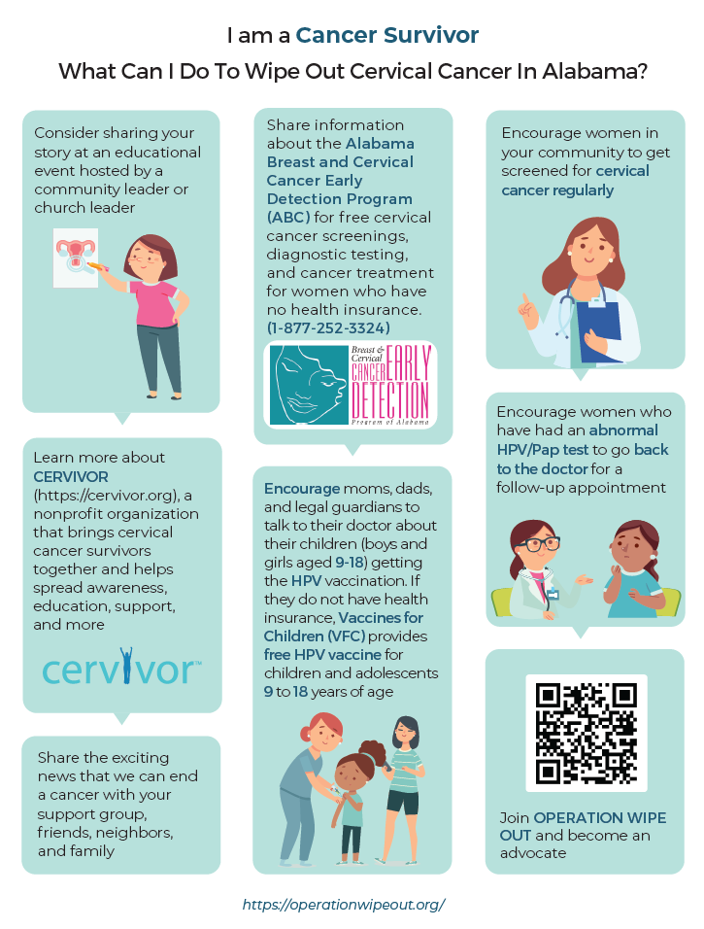

Slide 13

Regional Meetings w/Clinicians
Go Where the Primary Care Clinicians are
Gynecological Oncologist Provide HPV update (ASCCP app) (Imp of 16/18)
Provide Regional data
  Cervical cancer mortality/incidence maps
  Poverty/uninsured women maps
  ABC Program Screening/Diagnosis maps
Provide Time to Problem Solve Locally
7 Regional Meetings in North (Sept – Feb)
6 Regional Meetings in South (73 attendees)

Slide 14

WIPE OUT Regional Meetings: North
LAUDERDALE
LIMESTONE
MADISON
JACKSON
12
COLBERT
11
FRANKLIN
13
LAWRENCE
MORGAN
DEKALB
MARION
CULLMAN
MARSHALL
WINSTON
8
ETOWAH
CHEROKEE
BLOUNT
LAMAR
WALKER
FAYETTE
JEFFERSON
ST. CLAIR
CALHOUN
CLEBURNE
TALLADEGA
10
PICKENS
SHELBY
TUSCALOOSA
7
CLAY
RANDOLPH
To Register:
https://www.alabamapublichealth.gov/bandc/news
9
GREENE
BIBB
CHILTON
COOSA
TALLAPOOSA
CHAMBERS
HALE
PERRY
ELMORE
LEE
SUMTER
AUTAUGA
MARENGO
DALLAS
MONTGOMERY
MACON
BULLOCK
RUSSELL
CHOCTAW
LOWNDES
WILCOX
BUTLER
PIKE
BARBOUR
CLARKE
WASHINGTON
MONROE
CRENSHAW
HENRY
CONECUH
COFFEE
DALE
ESCAMBIA
COVINGTON
GENEVA
HOUSTON
MOBILE
NAMC
Huntsville HHS
Scheduling
Scheduling
Cullman CoC
Clay County Hsp
Riverview RMC
BALDWIN
2023/2024

Slide 15
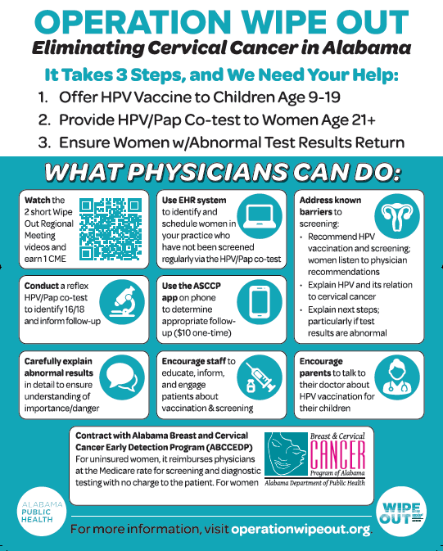
Alabama Academy of Family Practitioners
AL Chapter American Academy of Pediatricians
American College of Obstetricians and Gynecologists (ACOG) AL/Miss Joint Meeting
American College of Obstetricians and Gynecologists (ACOG) District VII
MASA/AAFP Magazine Ads

Slide 16
ADPH Mobile Colposcopy
NP Certified for Colposcopy
One NP per Six Districts
Travel to health departments within Districts
FY23: 791 colposcopies
FY24: 858 to date
69% Show Rate
22% High grade result

Slide 17
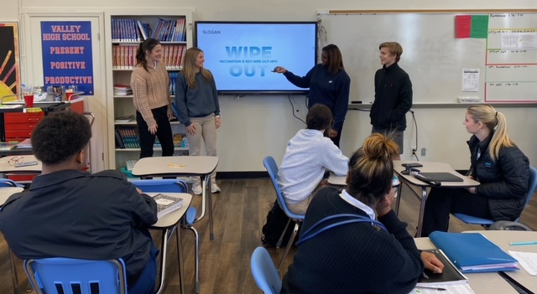



Vaccination
NCI Funding: Chambers County High School Students
HRSA Grant: Cahaba Medical Care/Wilcox County
ADPH Immunization Partnership
Notes:
Development, implementation and evaluation of a multi-channel communication campaign to promote HPV vaccination
Engagement of the entire school system
Community awareness
Provision of HPV vaccination in the schools

Slide 18
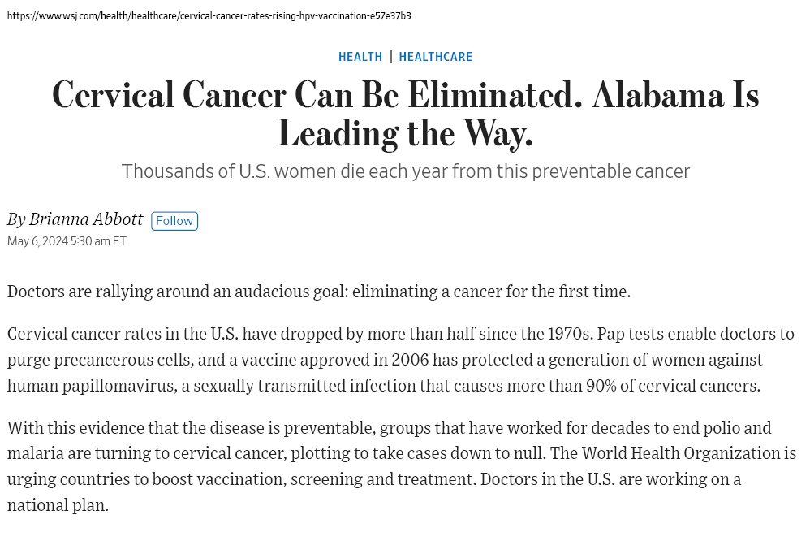
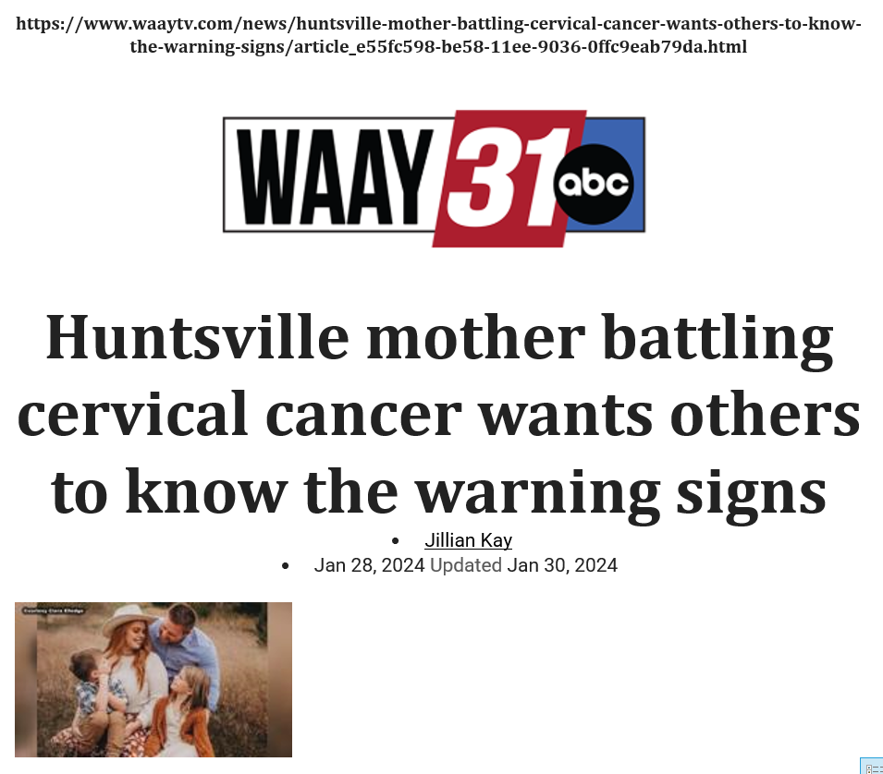
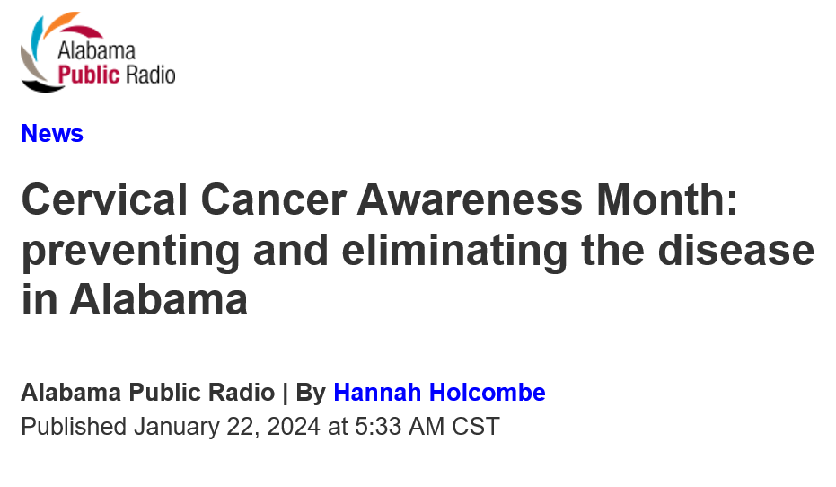
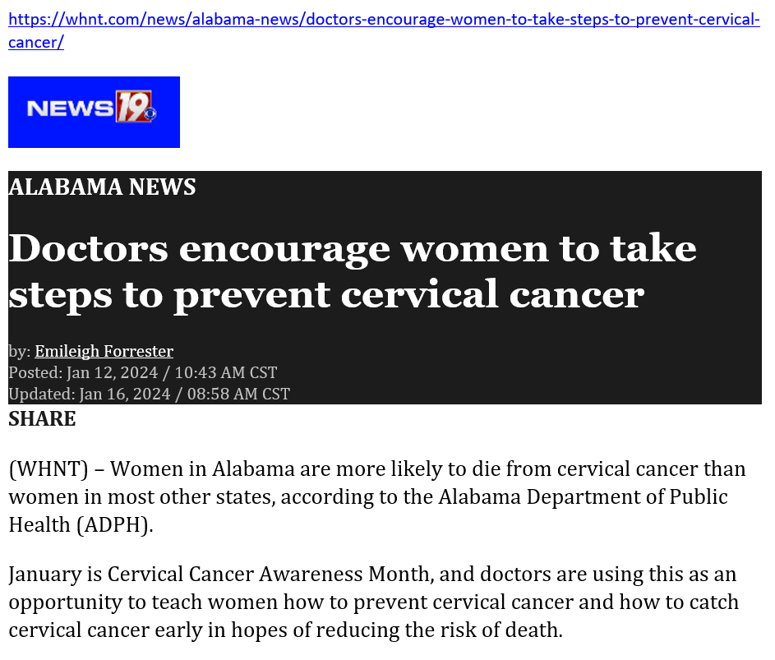
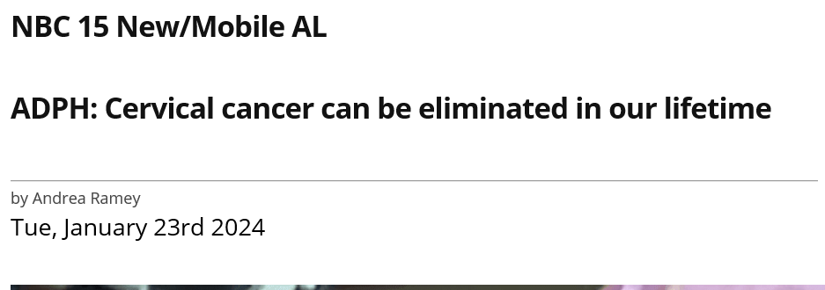
Getting the Word Out
Website
www.operationwipeout.org
Videos
Conquering Cervical Cancer in Alabama Documentary
Operation WIPE OUT in Alabama
Linda’s Story
Media
NBC Nightly News

Slide 19

Calhoun, Clay, Cleburne, Randolph,
and Talladega County
Regional Data
2024

Slide 20
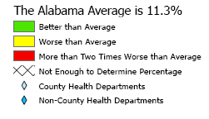
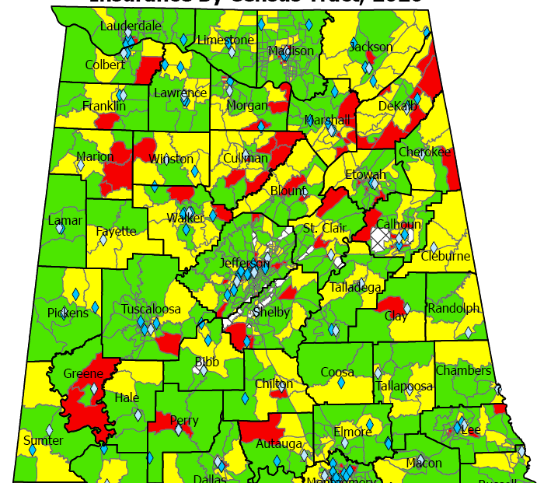
Uninsured Women Age 35-64
Census Tract, 2020
US Average: 10%
Source: United Sates Census Bureau (data.census.gov), 2023.

Slide 21
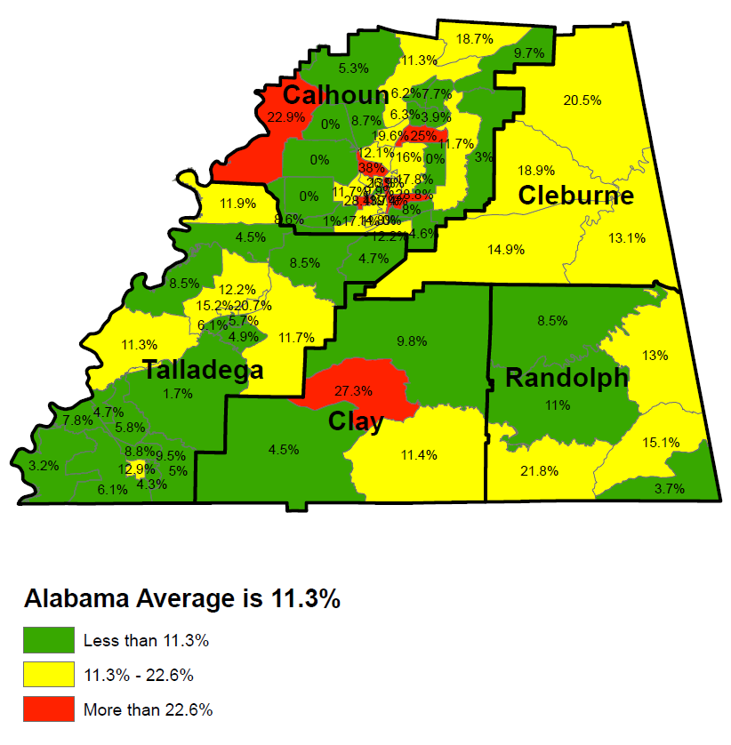
Uninsured Women Age 35-64
Census Tract, 2020
US Average: 10%
Source: United Sates Census Bureau (data.census.gov), 2023.
Notes:
The Alabama average of 14.3% below the poverty level is significantly worse than the US average of 10.2% for that age group. Likewise, the Alabama average of 11.3% with no insurance is significantly worse than the US average of 10.0% with no insurance for that age group.
Green means that Census Tract is at least better than the Alabama average, but does not necessarily mean it's good as it could still be worse than the national average.
Yellow means that Census Tract is the Alabama average or worse but not twice as worse. Keep in mind that means Yellow is also worse than the US.
Red means that Census Tract is more than twice as bad as the already terrible Alabama average.

Slide 22
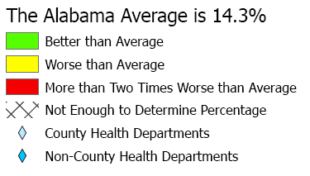
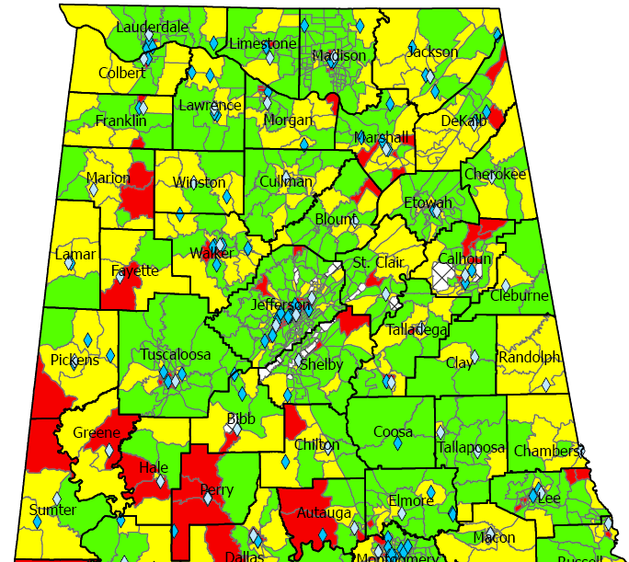
Federal Poverty Level Women Age 35-64
Census Tract, 2020
US Average: 10.2%
Source: United Sates Census Bureau (data.census.gov), 2023.

Slide 23
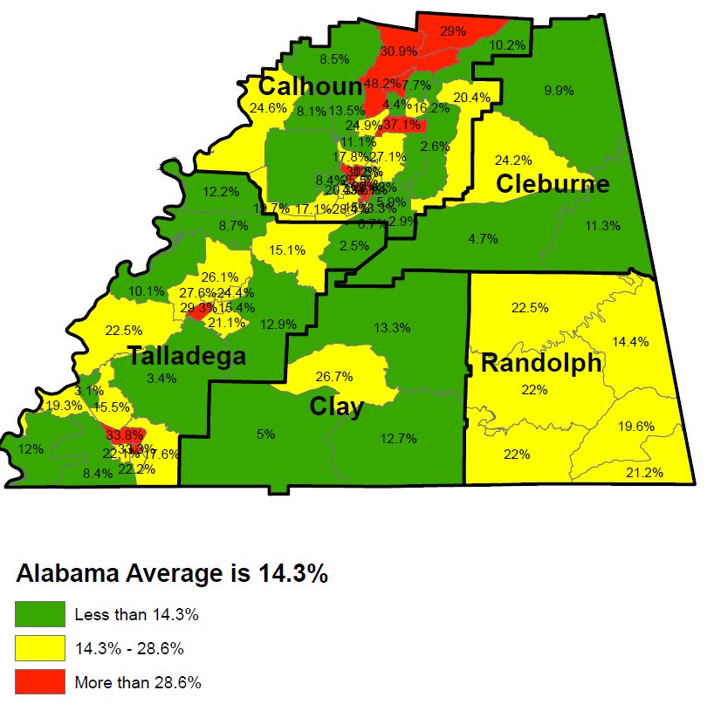
Federal Poverty Level Women Age 35-64
Census Tract, 2020
US Average: 10.2%
Source: United Sates Census Bureau (data.census.gov), 2023.

Slide 24
2023 HPV Vaccination Rates:
9-19 Years of Age
 | # Patients Up-to-Date Vaccine | % of Eligible
Calhoun | 6,211 | 26%
Clay | 762 | 33%
Cleburne | 620 | 19%
Randolph | 1,024 | 22%
Talladega | 3,651 | 29%
State Rate: 28%
Alabama IMMPRINT Data: 2023

Slide 25
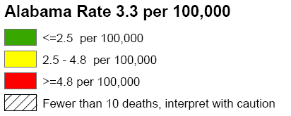
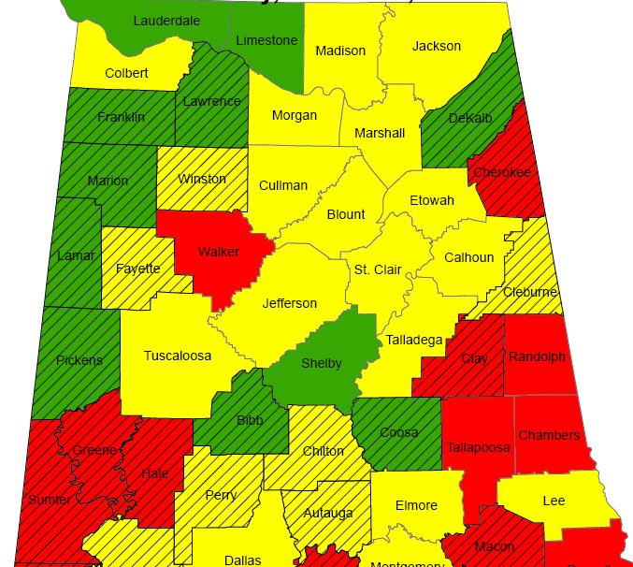
Cervical Cancer Mortality Rates:
2011-2020
National rate:
2.2 per 100,000

Slide 26
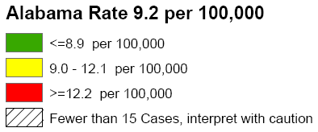
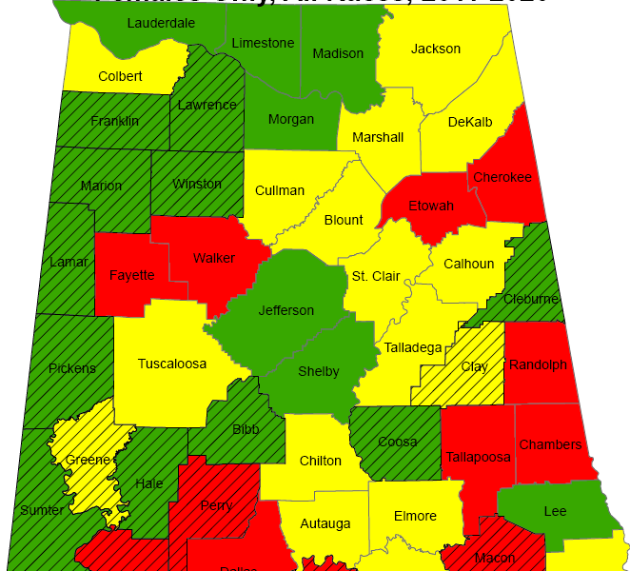
Cervical Cancer Incidence Rates:
2011-2020
National rate:
7.4 per 100,000

Slide 27
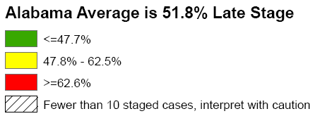
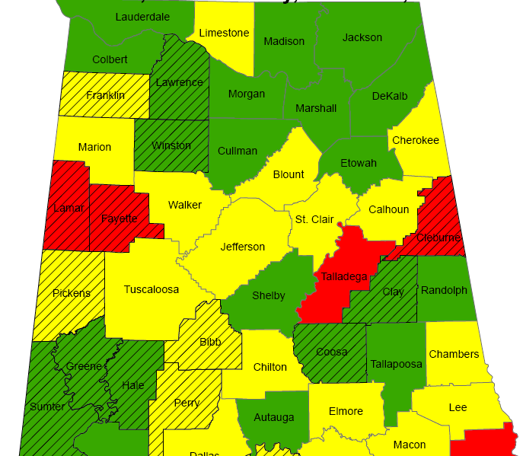
Cervical Cancer Late-Stage Cancer Rates:
2011-2020

Slide 28
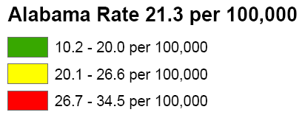
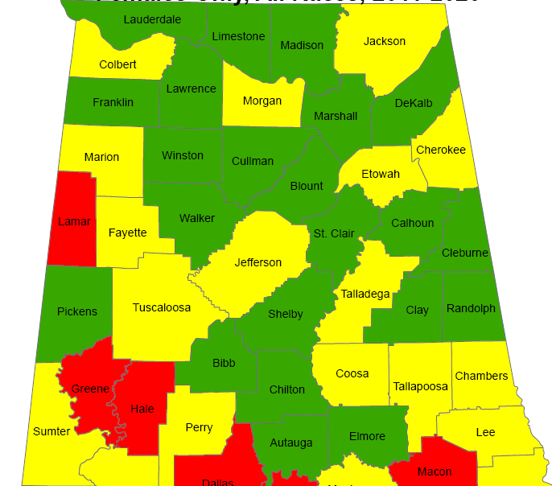
Breast Cancer Mortality Rates:
2011-2020

Slide 29
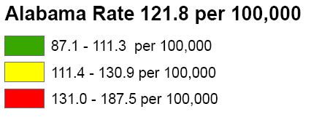
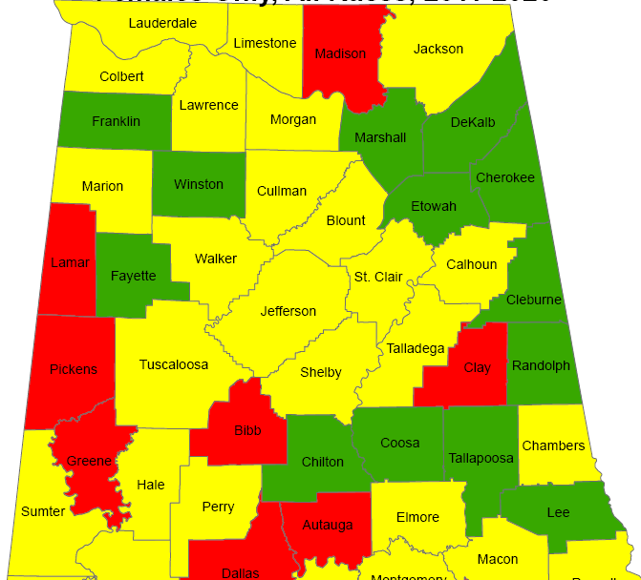
Breast Cancer Incidence Rates:
2011-2020

Slide 30
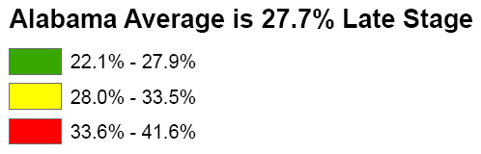
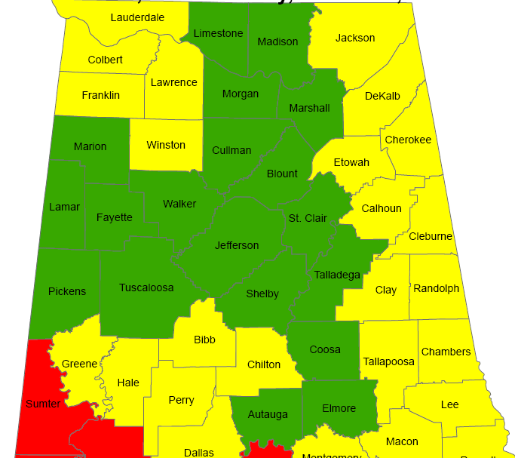
Breast Cancer Late-Stage Cancer Rates:
2011-2020

Slide 31
Alabama Breast and Cervical Cancer Early Detection Program (ABC)
Screening
Diagnostic Care
Treatment through Medicaid
No cost to the patient
Notes:
Services provided through 400+ contracted providers and county health departments.

Slide 32
ABC Eligible Women
  Age 40-64
  Income at or below 250% of Poverty Level
  No insurance
  Screening for Some High-Risk Women Under Age 40
  65+ Medicare Part A Only
Notes:
-CDC provides funding to every state in the nation
-We can print up eligibility guidelines to handout if you’d like

Slide 33
How is the Program Funded?
CDC
State of Alabama
Joy to Life Foundation
Notes:
ACS

Slide 34
Who Provides the Medical Care?
400+ contracted providers statewide
  Primary Care Providers
  Gynecologists
  Radiologists
  Mammogram facilities
  Surgeons
  FQHCs
County Health Departments
Notes:
Services provided through 400+ contracted providers and county health departments.

Slide 35
Reimbursement for Providers
Medicare reimbursement rates
  Office Visit $84.67
  Pap/HPV testing $55.35
  Genotyping (16/18) $40.55
  Colposcopy w/biopsy $151.16
  LEEP (Dx & Tx) $284.81
  Mammogram $117.47
  Mammogram dx $144.94
  Ultrasound $95.33
  Biopsy $54.32
Notes:
Services provided through 400+ contracted providers and county health departments.

Slide 36
Office Visit Reimbursement
Office Visit
  Established (99213): $84.67
Pap/HPV Lab
  Lab fee (88142): $20.26
  Pap/HPV: (87624): $35.09 $140.02
  Type 16/18 (87625): $40.55
Notes:
Services provided through 400+ contracted providers and county health departments.

Slide 37
Medicaid Treatment Act
Women Under 65 diagnosed with cancer
  At/Below 250% poverty level
  No Insurance
  Under age 65
  Live in Alabama
  Legally in the U.S.
  Documentation of Breast Cancer
  Documentation of Pre- or Invasive Cervical Cancer
Notes:
Services provided through 400+ contracted providers and county health departments.

Slide 38
Medical Advisory Committee
Gary Pugh, M.D. ADPH Medical Officer Family Health Services Kaye Melnick, MSN, RN ADPH Chief Nursing Officer
Trina Simmons, NP ADPH Nurse Practitioner Director Family Health Services
Warner Huh, M.D. Gynecologic Oncology University of AL Birmingham O’Neil Cancer Center Donna Lynn Dyess, M.D. Breast Surgeon University of South Alabama Mitchell Cancer Institute
Jennifer Young Pierce, M.D. Gynecologic Oncology University of South Alabama Mitchell Cancer Institute
Stephen Varner, M.D. Obstetrics/Gynecology University of South Alabama

Slide 39
ABC Regional Data:
Calhoun County
Clay County
Cleburne County
Randolph County
Talladega County

Slide 40
Women Screened by ABCCEDP
Alabama 2019 - 2023
62,621 women ABC Eligible
Eligible: Women who have no insurance and with an income of <= 250% of federal poverty level and 40-64 of age

Slide 41
Cervical Cancer Screening
2019 -2023
Notes:
2019: 275 2020: 126 2021: 192 2022: 197 2023: 189 Avg: 196 to 213…5% of State

Slide 42
Cervical Cancer & Pre-Cancer Detected
2019 - 2023
 |  | 2019 | 2020 | 2021 | 2022 | 2023
Calhoun | Cancer | 0 | 0 | 0 | 0 | 0
 | Pre-Cancer | 11 | 12 | 6 | 12 | 5
Clay | Cancer | 0 | 0 | 0 |  | 0
 | Pre-Cancer | 1 | 1 | 1 | 5 | 1
Cleburne | Cancer | 1 | 0 | 0 | 0 | 0
 | Pre-Cancer | 2 | 1 | 1 | 0 | 2
Randolph | Cancer | 0 | 0 | 0 | 0 | 0
 | Pre-Cancer | 2 | 3 | 0 | 1 | 2
Talladega | Cancer | 1 | 0 | 0 | 0 | 0
 | Pre-Cancer | 1 | 2 | 0 | 1 | 1
Alabama | Cancer | 12 | 6 | 6 | 6 | 4
 | Pre-Cancer | 447 | 409 | 319 | 488 | 497
 | % Cancer | 16.67% | 0.00% | 0.00% | 0.00% | 0.00%
 | % Pre-Cancer | 3.80% | 4.65% | 2.51% | 3.89% | 2.21%

Slide 43
Number of Colposcopies in Alabama: 2023
Calhoun County 20
Anniston OB GYN Associates PC 1
Northeast Alabama Regional Medical Center 5
OB/GYN & Associates of Anniston 2
OBGYN Associates of Anniston 12
Alabama: 791
Notes:
48%

Slide 44
Breast Cancer Screening
2019 -2023
Notes:
2019: 378 2020: 156 2021: 335 2022: 374 2023: 384 Avg: 325 to 367…4% of State

Slide 45
Breast Cancer Cases Detected
2019-2023
 | 2019 | 2020 | 2021 | 2022 | 2023
Calhoun | 5 | 2 | 3 | 2 | 0
Clay | 0 | 2 | 0 | 0 | 1
Cleburne | 1 | 0 | 0 | 1 | 0
Randolph | 0 | 1 | 1 | 0 | 0
Talladega | 0 | 3 | 1 | 0 | 0
Alabama | 110 | 97 | 100 | 78 | 59
 | 5.45% | 8.25% | 5.00% | 3.85% | 1.69%

Slide 46
Alabama Department of Public Health and Colposcopies
Nurse Practitioners (NP) certified for colposcopy
NPs supported by Medical Officer for Family Health Services
One NP per six Districts
Travel to health departments within Districts to provide colposcopy statewide
791 FY23
894 FY24
70% Show rate
22% High grade result

Slide 47
ABC Enrolling Providers
Calhoun County
  Calhoun County Health Department
  Quality of Life – Anniston
  Quality of Life – Calhoun
  OG/GYN Associates of Anniston
Cleburne County
  Cleburne County Health Department
  Quality of Life – Cleburne
Talladega County
  Talladega County Health Department
  Sylacauga County Health Department
  Quality of Life – Talladega
Clay County
  Clay County Health Department
  Quality of Life – Clay
Randolph County
  Randolph County Health Department
  Quality of Life – Wadley Cornerstone Clinic

Slide 48
ABC Mammogram Providers
Calhoun County
  Advanced Imaging of Alabama
  Northeast Alabama Regional Medical Center
Clay County
  Clay County Healthcare Authority
Talladega County
  BBH CBMC, LLC dba Citizens Baptist Medical Center
  Coosa Valley Medical Center

Slide 49
ABC Diagnostic Providers
Calhoun County
  Advanced Imaging AI
  Northeast Al Regional Medical
  Northeast Al Regional Medical Tyler Center
  Regional Medical Center Mediplex-Oxford
  The Surgical Clinic of Anniston
  B'ham Radiology Group
Clay County
  Clay County Healthcare Authority
  B'ham Radiology Group
Talladega County
  Citizens BMC
  Coosa Valley Medical Center
  B’ham Radiology Group

Slide 50
Contact Information
ABC Hotline:
1-877-252-3324
https://www.alabamapublichealth.gov/bandc/
ABC Medicaid Treatment
Kelli Hardy
334-206-2976
Kelli.Hardy@adph.state.al.us
Contracts/More Information:
Nancy Wright
334-206-5851
Nancy.wright@adph.state.al.us
Notes:
Dr. Pierce, HPV Impact on Cervical Cancer
Become ABC Provider
Join Operation WIPEOUT: Vaccine, screening, and Appr FU

Slide 51
Please complete the Evaluation
Thank you for Attending!

