Slide 1

Partnering to Eliminate Cervical Cancer in Alabama
Nancy Wright
Alabama Department of Public Health
September 2023

Slide 2
Eliminating Cervical Cancer is Possible
HPV Vaccination
Cervical Cancer Screening
Appropriate Follow-up
Timely Treatment

Slide 3
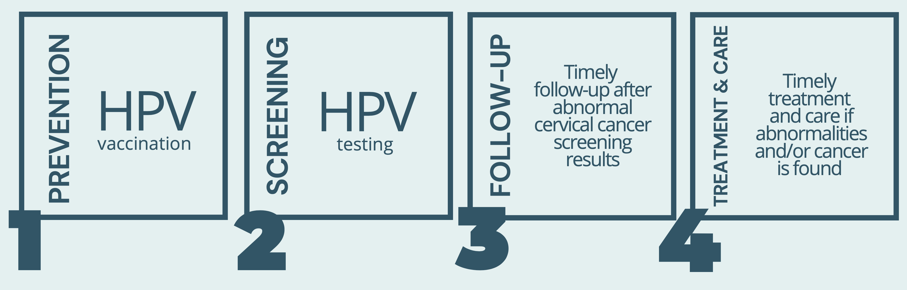
World Health Organization
Global call to Action to Eliminate Cervical Cancer
4 Key Strategies:

Slide 4
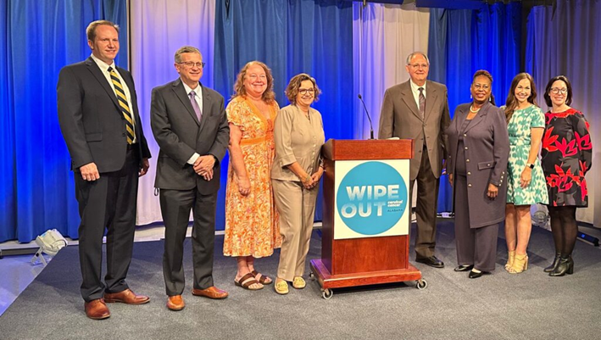

Press Conference:
Action Plan to Eliminate
Cervical Cancer in Alabama
Notes:
Launched

Slide 5
Operation WIPE OUT
Cervical Cancer Alabama
Alabama is the 1st State in the Nation to Announce a Statewide Effort to Eliminate Cervical Cancer in Alabama
May 8, 2023

Slide 6


Mobile, Baldwin, & Washington County
Regional Data
2023

Slide 7
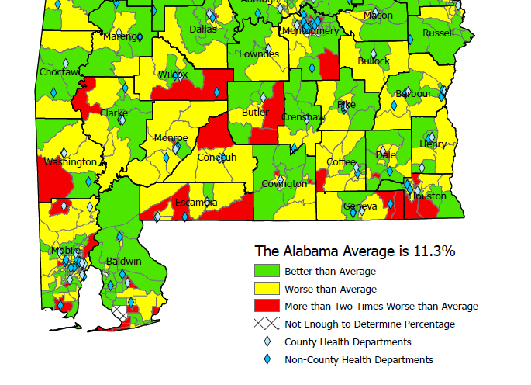
Uninsured Women Age 35-64
Census Tract, 2020
US Average: 10%

Slide 8
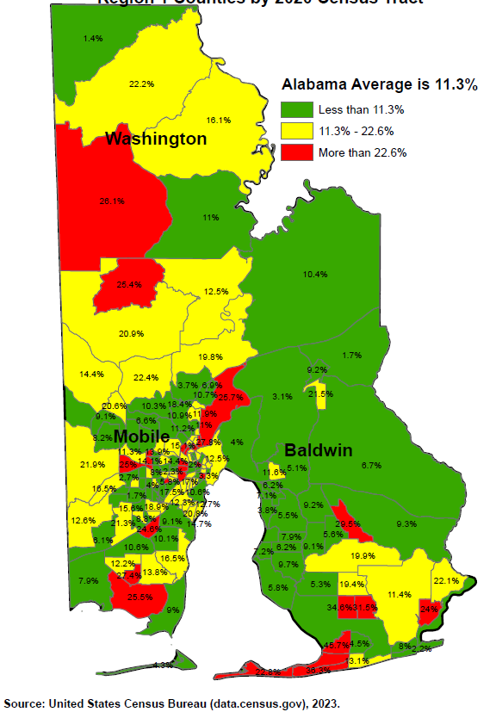
Uninsured Women Age 35-64
Census Tract, 2020
US Average: 10%
Notes:
The Alabama average of 14.3% below the poverty level is significantly worse than the US average of 10.2% for that age group. Likewise, the Alabama average of 11.3% with no insurance is significantly worse than the US average of 10.0% with no insurance for that age group.
Green means that Census Tract is at least better than the Alabama average, but does not necessarily mean it's good as it could still be worse than the national average.
Yellow means that Census Tract is the Alabama average or worse but not twice as worse. Keep in mind that means Yellow is also worse than the US.
Red means that Census Tract is more than twice as bad as the already terrible Alabama average.

Slide 9
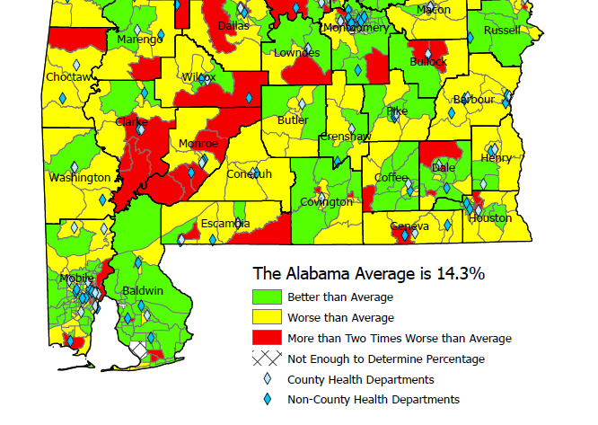
Federal Poverty Level Women Age 35-64
Census Tract, 2020
US Average: 10.2%

Slide 10
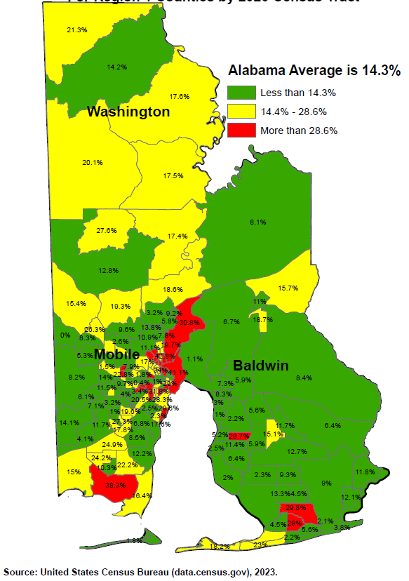
Federal Poverty Level Women Age 35-64
Census Tract, 2020
US Average: 10.2%

Slide 11
2023 HPV Vaccination Rates:
9-19 Years of Age
 | # Patients Up-to-Date Vaccine | % of Eligible
Mobile | 24,411 | 29%
Baldwin | 9,920 | 23%
Washington | 511 | 21%
State Rate: 27%

Slide 12
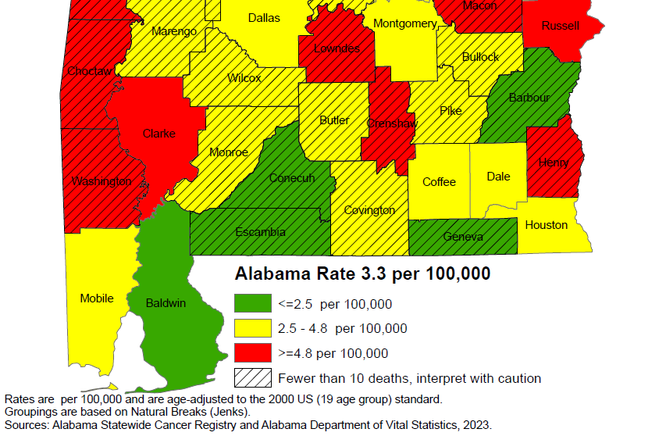
Cervical Cancer Mortality Rates:
2011-2020

Slide 13
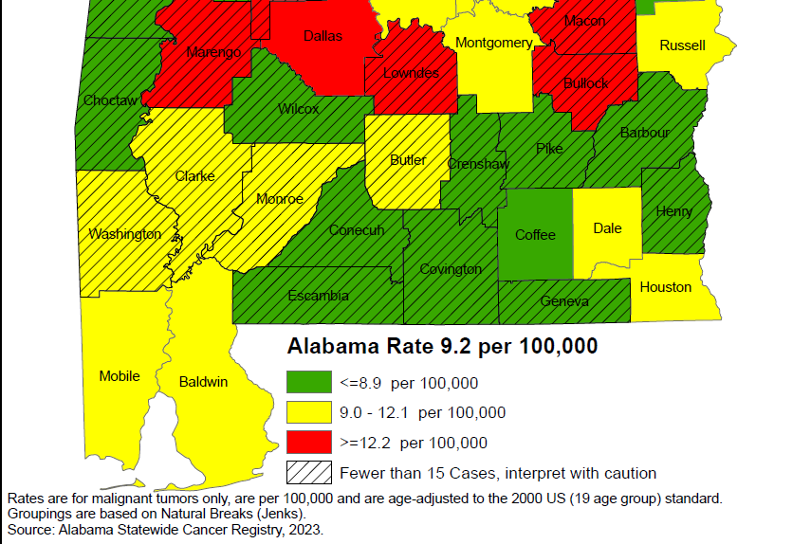
Cervical Cancer Incidence Rates:
2011-2020

Slide 14
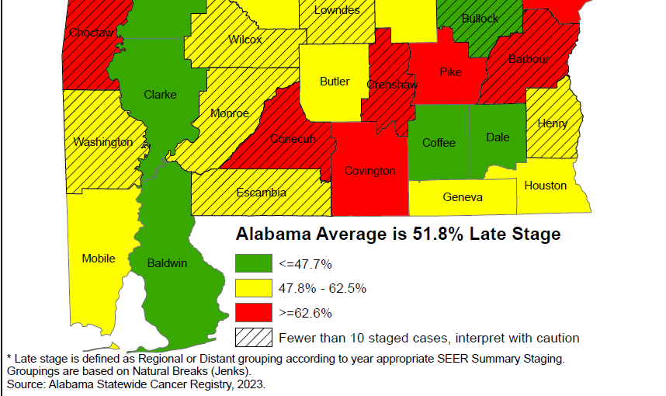
Cervical Cancer Late-Stage Cancer Rates:
2011-2020

Slide 15
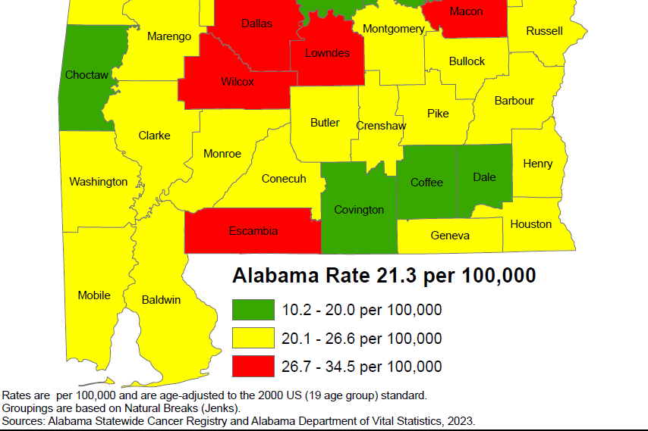
Breast Cancer Mortality Rates:
2011-2020

Slide 16
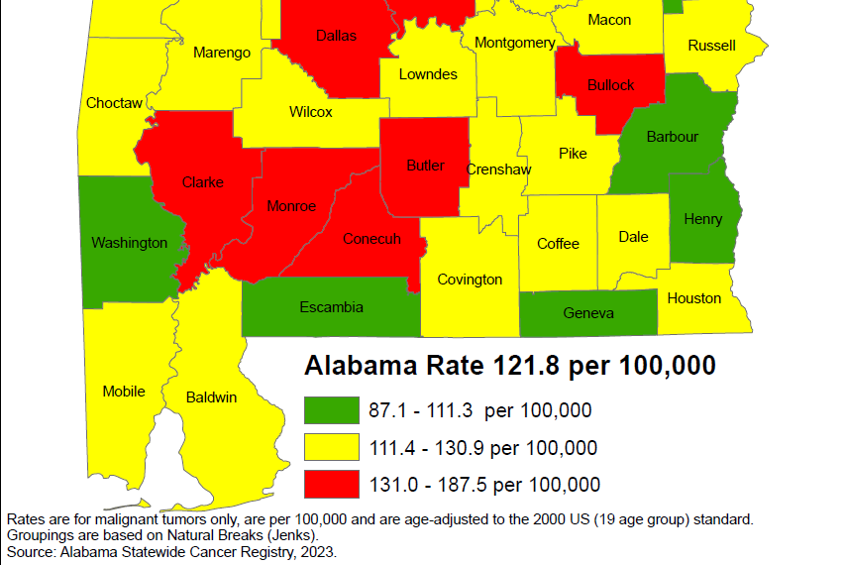
Breast Cancer Incidence Rates:
2011-2020

Slide 17
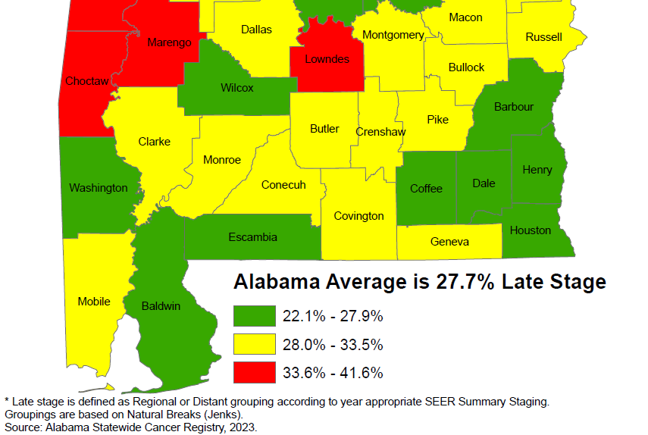
Breast Cancer Late-Stage Cancer Rates:
2011-2020

Slide 18
Alabama Breast and Cervical Cancer Early Detection Program (ABC)
Screening
Diagnostic Care
Treatment through Medicaid
No cost to the patient
Notes:
Services provided through 400+ contracted providers and county health departments.

Slide 19
ABC Eligible Women
  Age 40-64
  Income at or below 250% of Poverty Level
  No insurance
  Underinsured
  Screening for Some High-Risk Women Under Age 40
  65+ Medicare Part A Only
Notes:
-CDC provides funding to every state in the nation
-We can print up eligibility guidelines to handout if you’d like

Slide 20
How is the Program Funded?
CDC
State of Alabama
Joy to Life Foundation
Notes:
ACS

Slide 21
Who Provides the Medical Care?
400+ contracted providers statewide
  Primary Care Providers
  Gynecologists
  Radiologists
  Mammogram facilities
  Surgeons
  FQHCs
County Health Departments
Notes:
Services provided through 400+ contracted providers and county health departments.

Slide 22
Reimbursement for Providers
Medicare reimbursement rates
  Office Visit $84.67
  Pap/HPV testing $55.35
  Genotyping (16/18) $40.55
  Colposcopy w/biopsy $151.16
  LEEP (dx & tx) $284.81
  Mammogram $117.47
  Mammogram dx $144.94
  Ultrasound $95.33
  Biopsy $54.32
Notes:
Services provided through 400+ contracted providers and county health departments.

Slide 23
Office Visit Reimbursement
Office Visit
  Established (99213): $84.67
Pap/HPV Lab
  Lab fee (88142): $20.26
  Pap/HPV: (87624): $35.09 $140.02
  Type 16/18 (87625): $40.55
Notes:
Services provided through 400+ contracted providers and county health departments.

Slide 24
Medicaid Treatment Act
Women diagnosed with cancer
  At/Below 250% poverty level
  No Insurance
  Under age 65
  Live in Alabama
  Legally in the U.S.
Notes:
Services provided through 400+ contracted providers and county health departments.

Slide 25
Breast and Cervical Cancer
Medicaid Treatment Program
Women Under age 65 with an income of
< 250% of the Federal Poverty Level
Documentation of breast cancer diagnosis, abnormal Pap test indicating pre-cervical (CIN II or III), or invasive cervical cancer
No creditable insurance coverage
A legal U.S. citizen or a permanent resident card and have been in the U.S. for at least 5 years

Slide 26
Medical Advisory Committee
Gary Pugh, M.D. ADPH Medical Officer Family Health Services Kaye Melnick, MSN, RN ADPH Chief Nursing Officer
Trina Simmons, NP ADPH Nurse Practitioner Director Family Health Services
Warner Huh, M.D. Gynecologic Oncology University of AL Birmingham O’Neil Cancer Center Donna Lynn Dyess, M.D. Breast Surgeon University of South Alabama Mitchell Cancer Institute
Jennifer Young Pierce, M.D. Gynecologic Oncology University of South Alabama Mitchell Cancer Institute
Stephen Varner, M.D. Obstetrics/Gynecology University of South Alabama

Slide 27
ABC Regional Data:
Mobile County
Baldwin County
Washington County

Slide 28
Women Screened by ABCCEDP
Alabama 2018 - 2021
62,621 women ABC Eligible
Eligible: Women who have no insurance and with an income of <= 250% of federal poverty level and 40-64 of age

Slide 29
Cervical Cancer Screening in
Baldwin, Mobile, & Washington Counties
2018 -2022
Mobile County: 80%
Baldwin County: 19%
Washington County: 1%
Notes:
Calendar year
10% Cervical Cancer Screening

Slide 30
Cervical Cancer & Pre-Cancer Detected
2018 - 2022
 |  | 2018 | 2019 | 2020 | 2021 | 2022
Mobile | Cancer | 2 | 1 | 1 | 1 | 2
 | Pre-Cancer | 17 | 30 | 29 | 30 | 53
Baldwin | Cancer | 0 | 1 | 0 | 0 | 0
 | Pre-Cancer | 3 | 3 | 5 | 7 | 2
Washington | Cancer | 0 | 0 | 0 | 1 | 1
 | Pre-Cancer | 0 | 0 | 0 | 0 | 0
Alabama | Cancer | 12 | 12 | 6 | 6 | 6
 | Pre-Cancer | 250 | 447 | 409 | 319 | 488
 | % Cancer | 17% | 17% | 17% | 33% | 50%
 | % Pre-Cancer | 8% | 7% | 8% | 12% | 11%

Slide 31
Breast Cancer Screening
Baldwin, Mobile, & Washington Counties
2018 -2022
Mobile County: 80%
Baldwin County: 19%
Washington County: 1%
Notes:
20% breast cancer screening of ABC statewide

Slide 32
Breast Cancer Cases Detected
2018-2022
 | 2018 | 2019 | 2020 | 2021 | 2022
Mobile | 22 | 17 | 10 | 11 | 12
Baldwin | 2 | 3 | 7 | 4 | 2
Washington | 0 | 0 | 0 | 0 | 0
Alabama | 108 | 110 | 97 | 100 | 78
 | 22% | 18% | 17.5% | 15% | 18%

Slide 33
Number of Colposcopies in Alabama: 2022
Bayou La Batre: 21
Franklin Primary: 14
Gulf Regional Path: 1
Mobile County BOH: 2
Providence Hospital: 1
University South AL: 46
Victory Health Partners: 1
----------
Hope Center: 1
Precision Imaging: 1
Mobile: 86
Baldwin: 2
Washington: 0
Alabama: 762

Slide 34
Alabama Department of Public Health and Colposcopies
Nurse Practitioners (NP) certified for colposcopy
NPs supported by Medical Officer for Family Health Services
One NP per six Districts
Travel to health departments within Districts to provide colposcopy statewide
823+ performed this FY (Last FY 23)
72% Show rate
24% High grade result

Slide 35
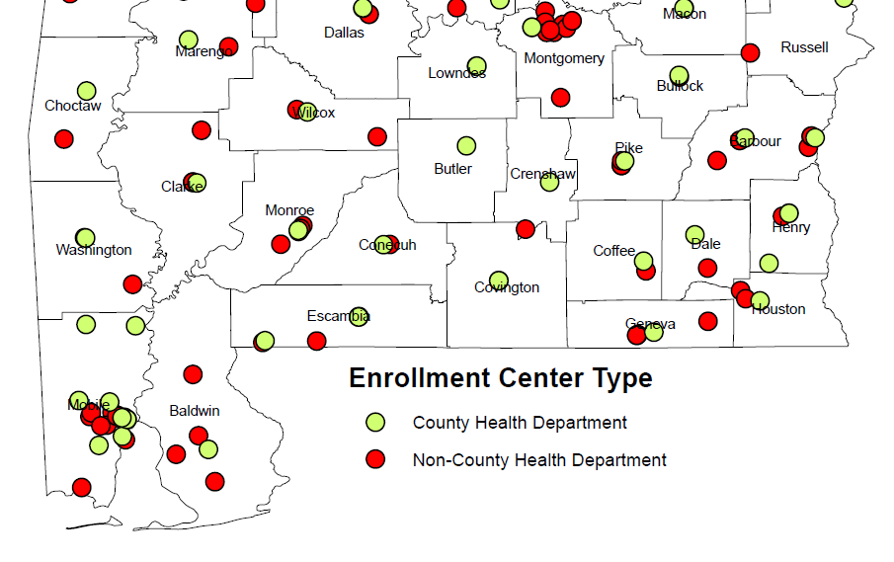
ABC Enrolling Providers

Slide 36
ABC Enrolling Providers
Mobile County Board of Health (MCHD)
MCHD - Citronelle Clinic
MCHD - Dauphin Island Parkway Health Center
MCHD - Eight Mile Clinic
MCHD - North Mobile Health Center
MCHD - Semmes Clinic
MCHD - Southwest Mobile Health Center
MCHD - Women's Health Center
Franklin Primary Health Center, Inc. (FPHC)
FPHC - Central Plaza Towers Medical Center
FPHC - Charles White Family Health Center
FPHC - Franklin Medical & Dental Express Mobile Unit
FPHC - Hadley Medical Center
FPHC - West Mobile Family Medical Center
FPHC - Aiello/Buskey Medical Center
FPHC - Dr. Albert Thomas Family Medicine
FPHC - H. E. Savage Memorial Center
FPHC - Maysville Medical Center
USA - Stanton Road Clinic
Victory Health Partners
AltaPointe Health Systems, Inc. - Accordia Health
Bayou La Batre Area Health Development Board
Baldwin County Health Department
Hope Center, Inc.
FPHC - North Baldwin Family Health Center
FPHC - South Baldwin Family Medical Center
Family Medical Center/Centro Medico Familiar
Southwest Alabama Health Services
Washington County Health Department

Slide 37
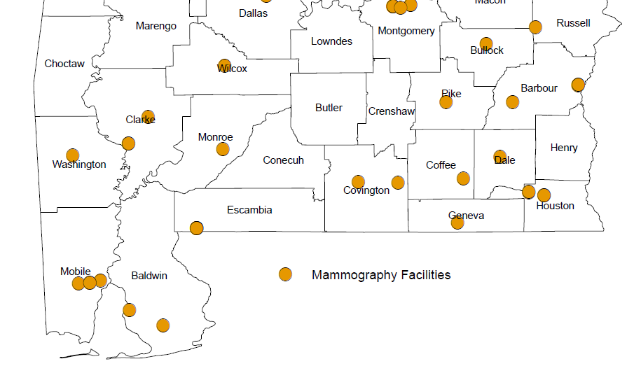
ABC Mammogram Providers

Slide 38
ABC Mammogram Providers
Franklin Primary Health Center, Inc.
Providence Hospital
Springhill Hospitals, Inc.
USA Medical Center
USA Children’s and Women’s Hospital
USA Family Practice
Gulf Health Hospitals Inc. dba Thomas Hospital
South Baldwin Regional Medical Center
Washington County Hospital & Nursing Home

Slide 39
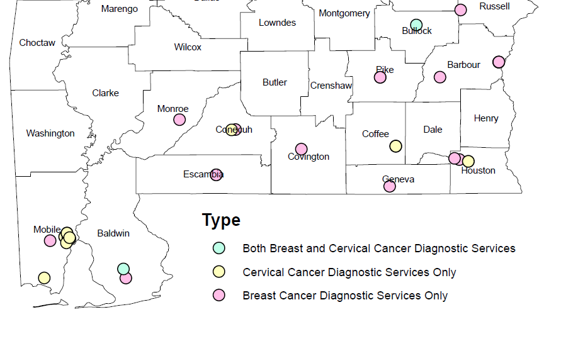
ABC Diagnostic Providers

Slide 40
ABC Diagnostic Providers
Franklin Primary Health Center, Inc.
USA - Dept of Pathology
USA Laboratories
Gulf Regional Pathologists, P.A.
Foley Clinic Corporation

Slide 41
Contact Information
ABC Hotline:
https://www.alabamapublichealth.gov/bandc/
ABC Medicaid Treatment
Kelli Hardy
334-206-2976
Kelli.Hardy@adph.state.al.us
Contracts/More Information:
Nancy Wright
334-206-5851
Nancy.wright@adph.state.al.us
Notes:
Dr. Pierce, HPV Impact on Cervical Cancer
Become ABC Provider
Join Operation WIPEOUT: Vaccin, screening, and Appr FU

