Slide 1
Please complete the pre-survey in your packet or through the link in the Zoom Chat
Welcome!

Slide 2
Partnering to Eliminate Cervical Cancer in Alabama
Nancy Wright
Alabama Department of Public Health
September 2023

Slide 3
Eliminating Cervical Cancer: What Can You Do?
Join Operation WIPE OUT
Assess Your Region’s Needs
Become an ABCCEDP Provider
Become an Advocate in Your Region

Slide 4
Eliminating Cervical Cancer is Possible
HPV Vaccination
Cervical Cancer Screening
Appropriate Follow-up
Timely Treatment

Slide 5
World Health Organization Global call to Action to Eliminate Cervical Cancer
4 Key Strategies:

Slide 6
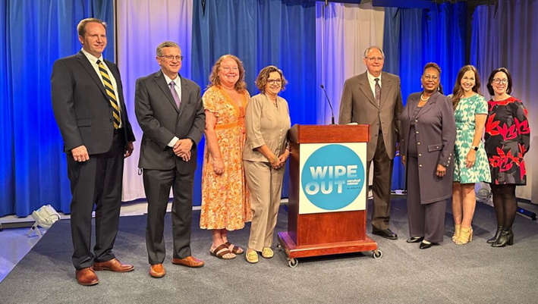
Press Conference: Action Plan to Eliminate Cervical Cancer in Alabama
Notes:
Launched

Slide 7
Operation WIPE OUT Cervical Cancer Alabama
Alabama is the 1st State in the Nation to Announce a Statewide Effort to Eliminate Cervical Cancer in Alabama
May 8, 2023

Slide 8
Conecuh, Clarke, Escambia, & Monroe County Regional Data
2023

Slide 9
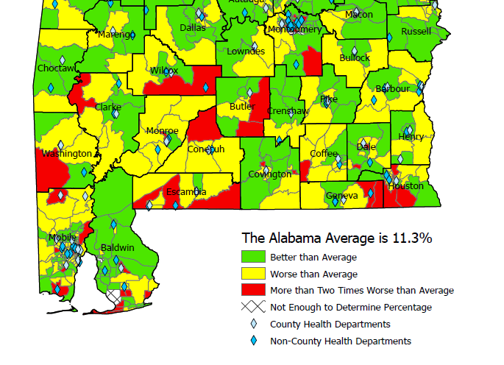
Uninsured Women Age 35-64 Census Tract, 2020
US Average: 10%

Slide 10
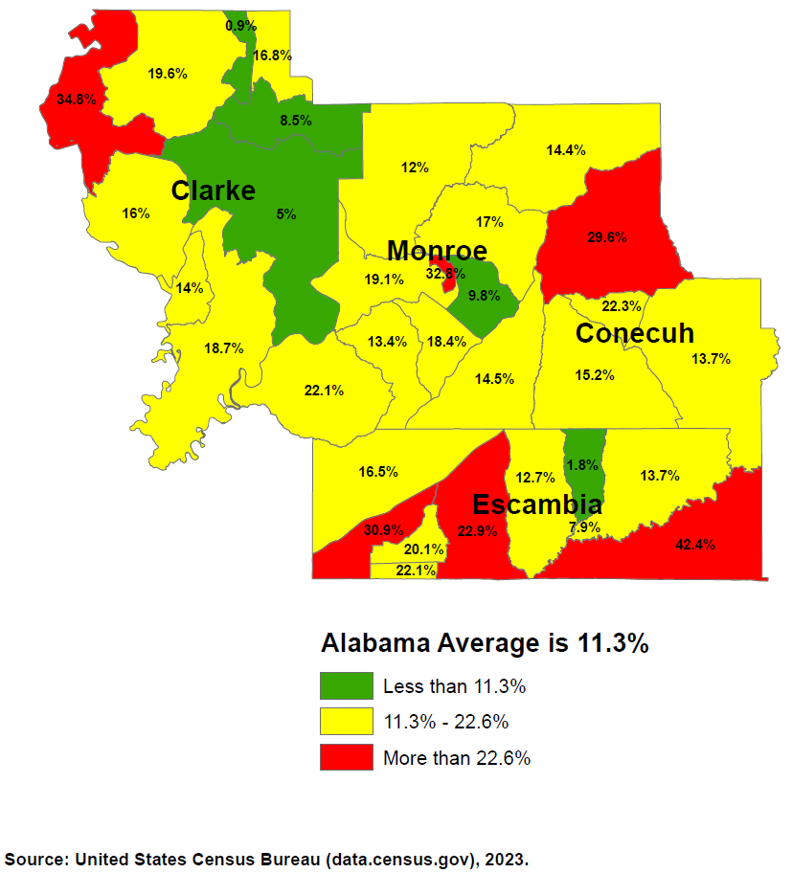
Uninsured Women Age 35-64 Census Tract, 2020
US Average: 10%
Notes:
The Alabama average of 14.3% below the poverty level is significantly worse than the US average of 10.2% for that age group. Likewise, the Alabama average of 11.3% with no insurance is significantly worse than the US average of 10.0% with no insurance for that age group.
Green means that Census Tract is at least better than the Alabama average, but does not necessarily mean it's good as it could still be worse than the national average.
Yellow means that Census Tract is the Alabama average or worse but not twice as worse. Keep in mind that means Yellow is also worse than the US.
Red means that Census Tract is more than twice as bad as the already terrible Alabama average.

Slide 11
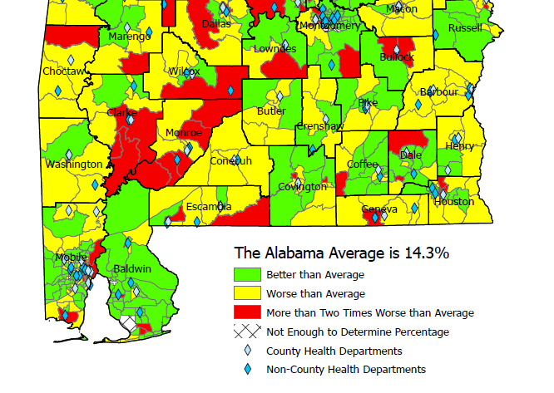
Federal Poverty Level Women Age 35-64 Census Tract, 2020
US Average: 10.2%

Slide 12
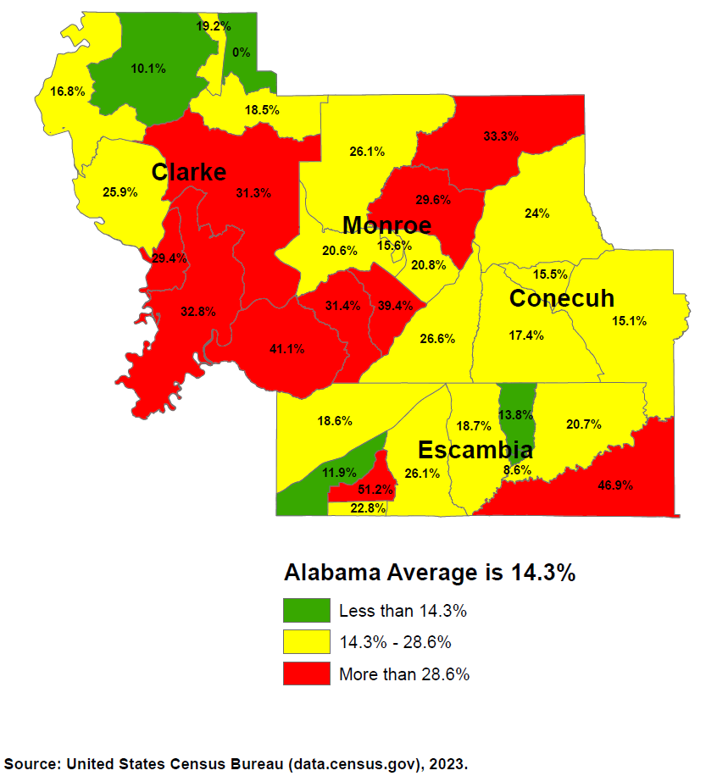
Federal Poverty Level Women Age 35-64 Census Tract, 2020
US Average: 10.2%

Slide 13
2023 HPV Vaccination Rates: 9-19 Years of Age
 | # Patients Up-to-Date Vaccine | % of Eligible
Conecuh | 440 | 22%
Clarke | 608 | 15%
Escambia | 1,407 | 19%
Monroe | 972 | 29%
State Rate: 27%
Alabama IMMPRINT Data; January 1st– September 30th 2023

Slide 14
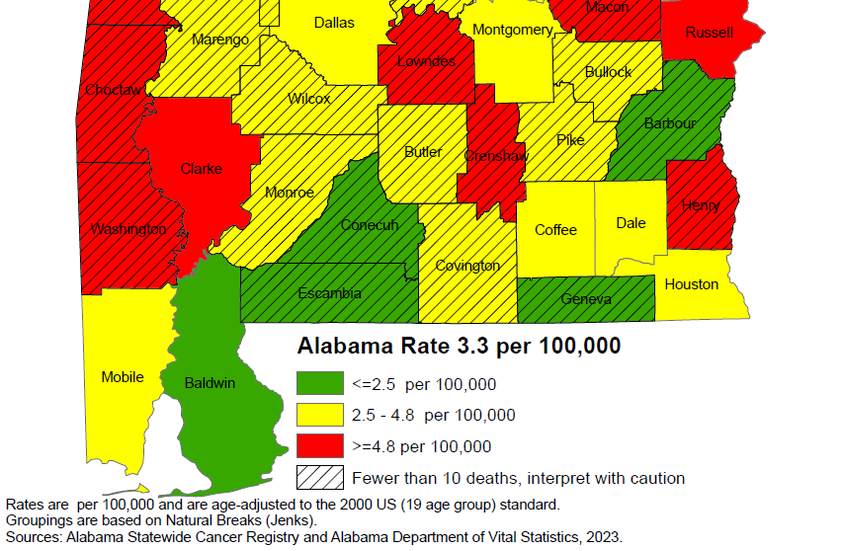
Cervical Cancer Mortality Rates: 2011-2020
National rate: 2.2 per 100,000

Slide 15
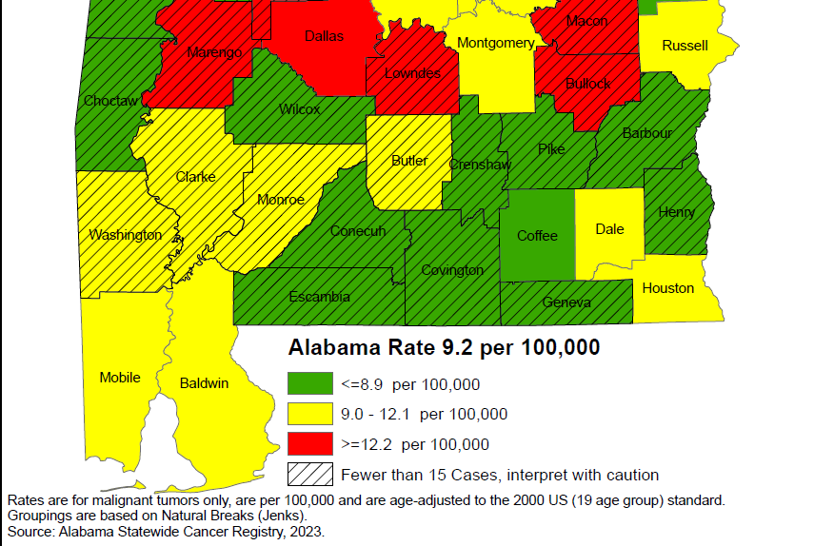
Cervical Cancer Incidence Rates: 2011-2020
National rate: 7.4 per 100,000

Slide 16
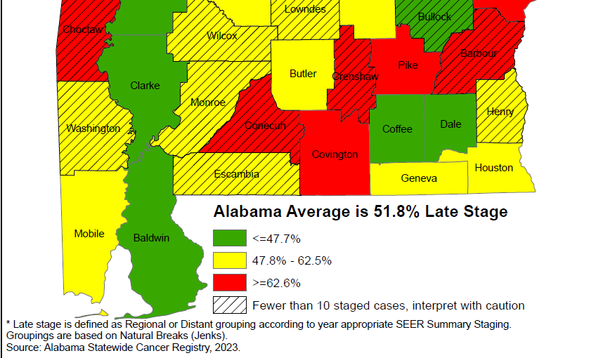
Cervical Cancer Late-Stage Cancer Rates: 2011-2020

Slide 17
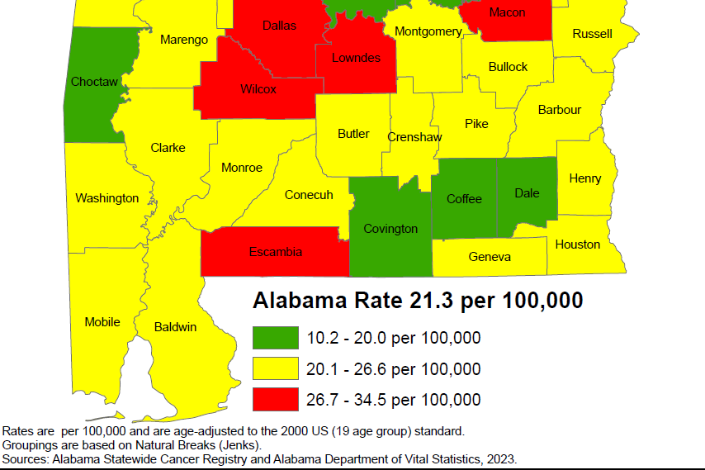
Breast Cancer Mortality Rates: 2011-2020

Slide 18
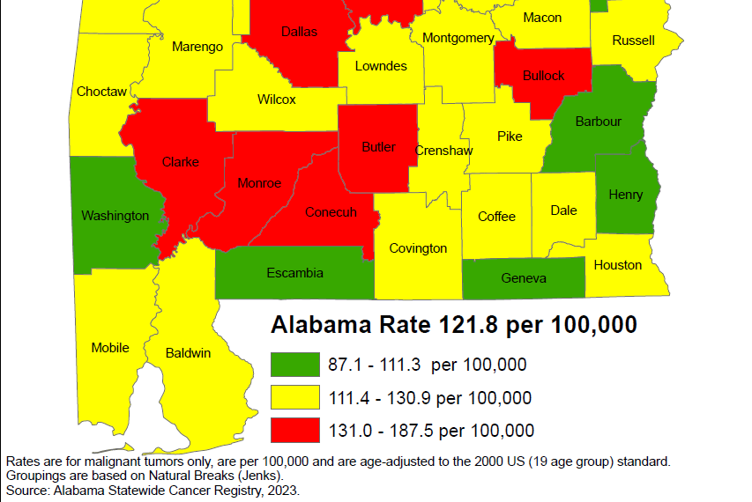
Breast Cancer Incidence Rates: 2011-2020

Slide 19
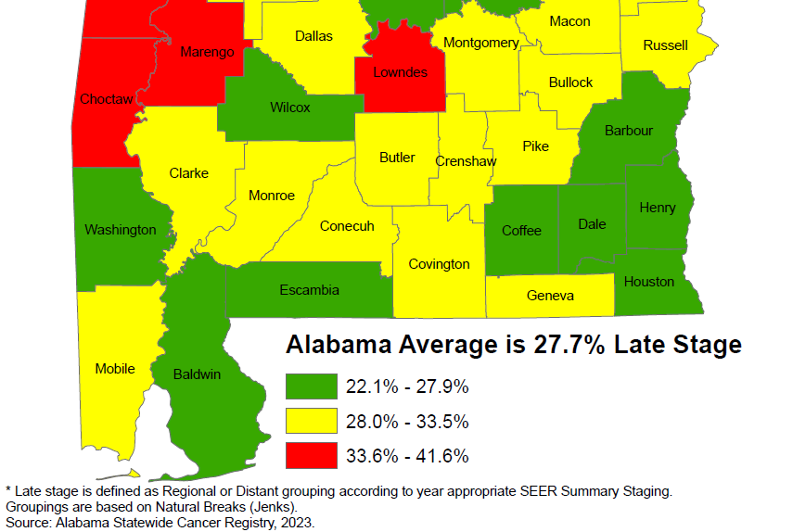
Breast Cancer Late-Stage Cancer Rates: 2011-2020

Slide 20
Alabama Breast and Cervical Cancer Early Detection Program (ABC)
Screening
Diagnostic Care
Treatment through Medicaid
No cost to the patient
Notes:
Services provided through 400+ contracted providers and county health departments.

Slide 21
ABC Eligible Women
Age 40-64
Income at or below 250% of Poverty Level
No insurance
Underinsured
Screening for Some High-Risk Women Under Age 40
65+ Medicare Part A Only
Notes:
-CDC provides funding to every state in the nation
-We can print up eligibility guidelines to handout if you’d like

Slide 22
How is the Program Funded?
CDC
State of Alabama
Joy to Life Foundation
Notes:
ACS

Slide 23
Who Provides the Medical Care?
400+ contracted providers statewide
Primary Care Providers
Gynecologists
Radiologists
Mammogram facilities
Surgeons
FQHCs
County Health Departments
Notes:
Services provided through 400+ contracted providers and county health departments.

Slide 24
Reimbursement for Providers
Medicare reimbursement rates
Office Visit $84.67
Pap/HPV testing $55.35
Genotyping (16/18) $40.55
Colposcopy w/biopsy $151.16
LEEP (Dx & Tx) $284.81
Mammogram $117.47
Mammogram dx $144.94
Ultrasound $95.33
Biopsy $54.32
Notes:
Services provided through 400+ contracted providers and county health departments.

Slide 25
Office Visit Reimbursement
Office Visit
Established (99213): $84.67
Pap/HPV Lab
Lab fee (88142): $20.26
Pap/HPV: (87624): $35.09 $140.02
Type 16/18 (87625): $40.55
Notes:
Services provided through 400+ contracted providers and county health departments.

Slide 26
Medicaid Treatment Act
Women Under 65 diagnosed with cancer
At/Below 250% poverty level
No Insurance
Under age 65
Live in Alabama
Legally in the U.S.
Documentation of Breast Cancer
Documentation of Pre- or Invasive Cervical Cancer
Notes:
Services provided through 400+ contracted providers and county health departments.

Slide 27
Medical Advisory Committee
Gary Pugh, M.D. ADPH Medical Officer Family Health Services Kaye Melnick, MSN, RN ADPH Chief Nursing Officer
Trina Simmons, NP ADPH Nurse Practitioner Director Family Health Services
Warner Huh, M.D. Gynecologic Oncology University of AL Birmingham O’Neil Cancer Center Donna Lynn Dyess, M.D. Breast Surgeon University of South Alabama Mitchell Cancer Institute
Jennifer Young Pierce, M.D. Gynecologic Oncology University of South Alabama Mitchell Cancer Institute
Stephen Varner, M.D. Obstetrics/Gynecology University of South Alabama

Slide 28
ABC Regional Data:
Clarke County
Conecuh County
Escambia County
Monroe County

Slide 29
Women Screened by ABCCEDP
Alabama 2018 - 2022
Total Screened
Screened for Breast
Screened for Cervical
62,621 women ABC Eligible
Eligible: Women who have no insurance and with an income of <= 250% of federal poverty level and 40-64 of age

Slide 30
Cervical Cancer Screening in Clark, Conecuh, Escambia & Monroe Counties 2018 -2022
Notes:
2018: 93 2019:107 2020: 49 2021:62 2022: 75 Avg: 62-75…..2% of State

Slide 31
Cervical Cancer & Pre-Cancer Detected 2018 - 2022
 |  | 2018 | 2019 | 2020 | 2021 | 2022
Escambia | Cancer | 1 | 0 | 0 | 0 | 0
 | Pre-Cancer | 3 | 9 | 2 | 4 | 1
Clark | Cancer | 0 | 0 | 0 | 0 | 0
 | Pre-Cancer | 0 | 2 | 0 | 0 | 10
Monroe | Cancer | 0 | 0 | 0 | 0 | 0
 | Pre-Cancer | 0 | 0 | 5 | 1 | 3
Conecuh | Cancer | 0 | 0 | 0 | 0 | 0
 | Pre-Cancer | 1 | 2 | 2 | 1 | 3
Alabama | Cancer | 12 | 12 | 6 | 6 | 6
 | Pre-Cancer | 250 | 447 | 409 | 319 | 488
 | % Cancer | 8% | 0% | 0% | 0% | 0%
 | % Pre-Cancer | 2% | 3% | 2% | 2% | 3%

Slide 32
Number of Colposcopies in Alabama: 2022
Clarke County HD: 8
D.W. McMillan: 4
Surgical Ass. of S AL: 1
Vivid Pathology: 1
Monroe Count HD: 6
Monroeville MC: 1
Primary Care Ctr: 9
Clarke: 8
Conecuh: 0
Escambia: 6
Monroe: 16
Alabama: 762

Slide 33
Breast Cancer Screening Clarke, Conecuh, Escambia, & Monroe 2018 -2022
Notes:
2018: 192 2019:189 2020: 110 2021: 120 2022: 134 Avg: 149-160…..2% of state

Slide 34
Breast Cancer Cases Detected 2018-2022
 | 2018 | 2019 | 2020 | 2021 | 2022
Escambia | 1 | 0 | 1 | 0 | 0
Clark | 1 | 1 | 1 | 0 | 0
Monroe | 0 | 1 | 0 | 0 | 0
Conecuh | 0 | 0 | 1 | 0 | 0
Alabama | 108 | 110 | 97 | 100 | 78
 | 2% | 2% | 3% | 0% | 0%

Slide 35
Alabama Department of Public Health and Colposcopies
Nurse Practitioners (NP) certified for colposcopy
NPs supported by Medical Officer for Family Health Services
One NP per six Districts
Travel to health departments within Districts to provide colposcopy statewide
823+ performed this FY (Last FY 23)
72% Show rate
24% High grade result

Slide 36
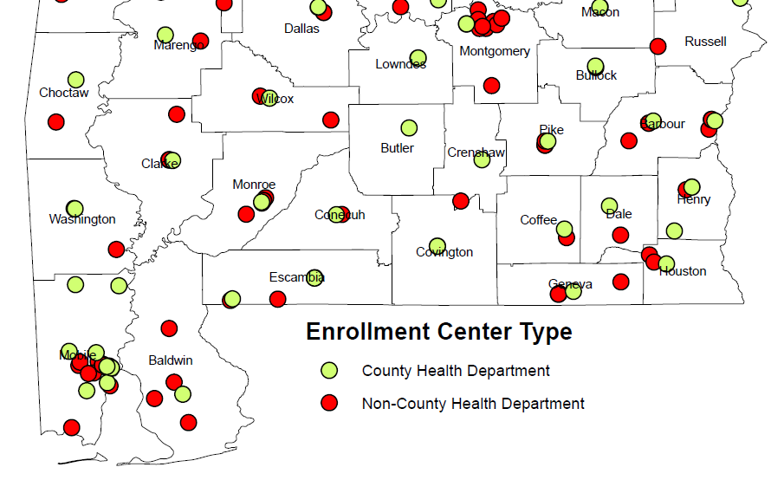
ABC Enrolling Providers

Slide 37
ABC Enrolling Providers
Clarke CHD
Grove Hill Healthcare Clinic
Grove Hill Primary Care
RHMPI - Thomasville Hlth Ctr
Monroe CHD
Primary Care Center of Monroeville
Monroe Cty Hsp Rural Health Clinic (MCH Physicians Group)
RMPHI - Monroeville Health Ctr
FPHC- Frisco City Family MC
Conecuh CHD
FPHC- Evergreen Family MC
FPHC Evergreen Family Hlth Ctr
Evergreen Primary Care
Escambia CHD – Brewton
Escambia CHD - Atmore
D.W. McMillan MC
Flomaton Medical Center
FPHC- Franklin Brewton Family Medical
ACH Complete Care
ACH Family Physicians
ACH MedPlus
ACH Primary Care

Slide 38
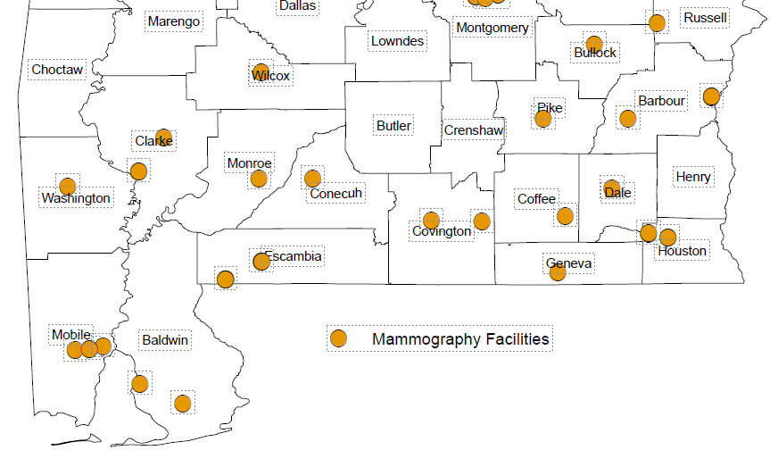
ABC Mammogram Providers

Slide 39
ABC Mammogram Providers
Jackson Medical Center, LLC (Clarke)
Grove Hill Memorial Hospital (Clarke)
Evergreen Medical Center, LLC (Conecuh)
Atmore Community Hospital (Escambia)
DW McMillan Memorial Hospital (Escambia)
Monroe County Hospital (Monroe)

Slide 40
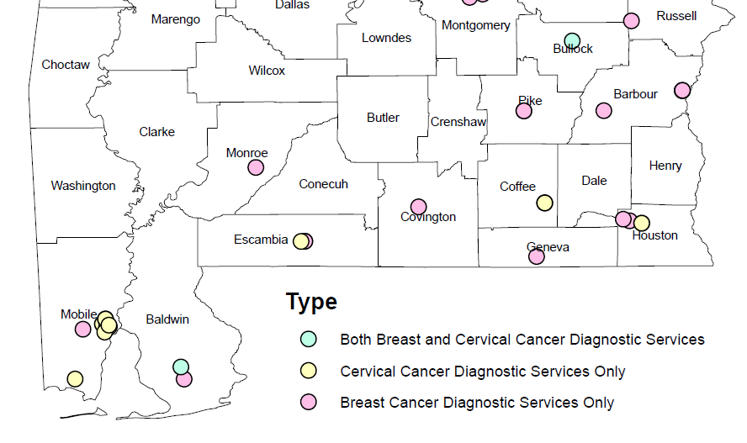
ABC Diagnostic Providers

Slide 41
ABC Diagnostic Providers
D W McMillan Surgical Group, LLC (Escambia)
D.W. McMillan Medical Center (Escambia)
Monroe County Hospital Surgery Clinic (Monroe)

Slide 42
Contact Information
ABC Hotline:
https://www.alabamapublichealth.gov/bandc/
ABC Medicaid Treatment
Kelli Hardy
334-206-2976
Kelli.Hardy@adph.state.al.us
Contracts/More Information:
Nancy Wright
334-206-5851
Nancy.wright@adph.state.al.us
Notes:
Dr. Pierce, HPV Impact on Cervical Cancer
Become ABC Provider
Join Operation WIPEOUT: Vaccine, screening, and Appr FU

Slide 43
Please complete the Evaluation in your packet or through the link in the Zoom Chat
Thank you for Attending!

