Slide 1

Partnering to Eliminate Cervical Cancer in Alabama
Nancy Wright
Alabama Department of Public Health
September 2023

Slide 2
Eliminating Cervical Cancer:
What Can You Do?
Join Operation WIPE OUT
Assess Your Region’s Needs
Become an ABCCEDP Provider
Become an Advocate in Your Region

Slide 3
Eliminating Cervical Cancer is Possible
HPV Vaccination
Cervical Cancer Screening
Appropriate Follow-up
Timely Treatment

Slide 4
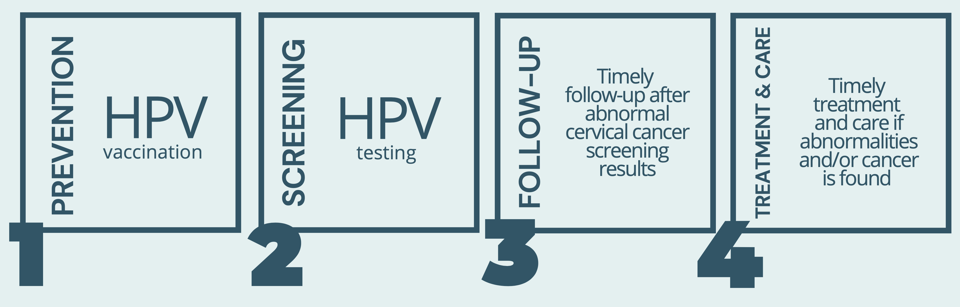
World Health Organization
Global call to Action to Eliminate Cervical Cancer
4 Key Strategies:

Slide 5
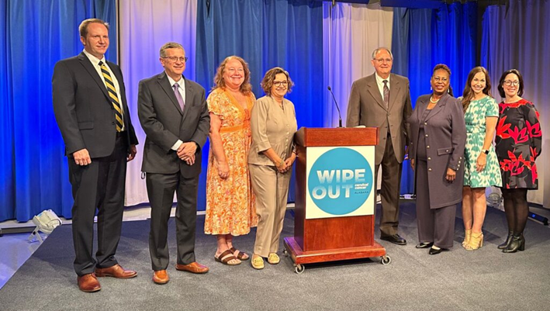

Press Conference:
Action Plan to Eliminate
Cervical Cancer in Alabama
Notes:
Launched

Slide 6
Operation WIPE OUT
Cervical Cancer Alabama
Alabama is the 1st State in the Nation to Announce a Statewide Effort to Eliminate Cervical Cancer in Alabama
May 8, 2023

Slide 7


Barbour, Coffee, Covington, Dale, Geneva, Henry, & Houston County
Regional Data
2023

Slide 8
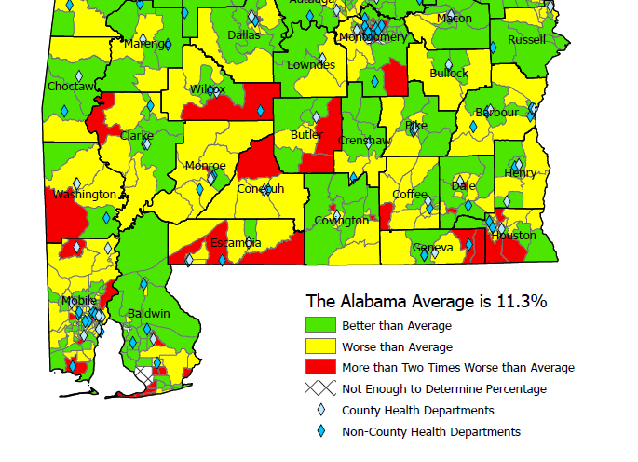
Uninsured Women Age 35-64
Census Tract, 2020
US Average: 10%

Slide 9
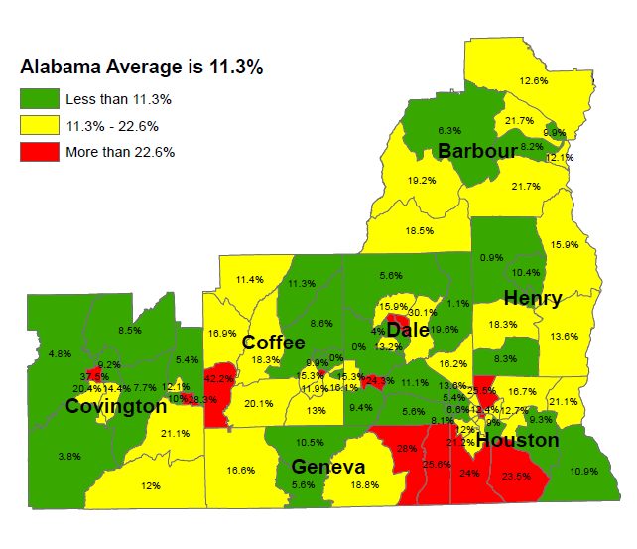
Uninsured Women Age 35-64
Census Tract, 2020
US Average: 10%
Notes:
The Alabama average of 14.3% below the poverty level is significantly worse than the US average of 10.2% for that age group. Likewise, the Alabama average of 11.3% with no insurance is significantly worse than the US average of 10.0% with no insurance for that age group.
Green means that Census Tract is at least better than the Alabama average, but does not necessarily mean it's good as it could still be worse than the national average.
Yellow means that Census Tract is the Alabama average or worse but not twice as worse. Keep in mind that means Yellow is also worse than the US.
Red means that Census Tract is more than twice as bad as the already terrible Alabama average.

Slide 10
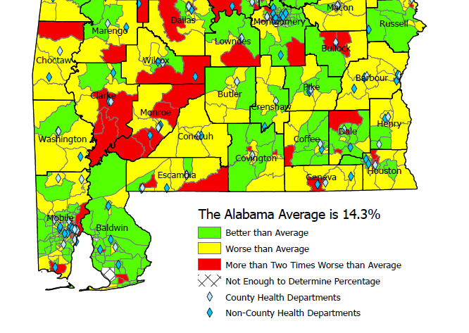
Federal Poverty Level Women Age 35-64
Census Tract, 2020
US Average: 10.2%

Slide 11
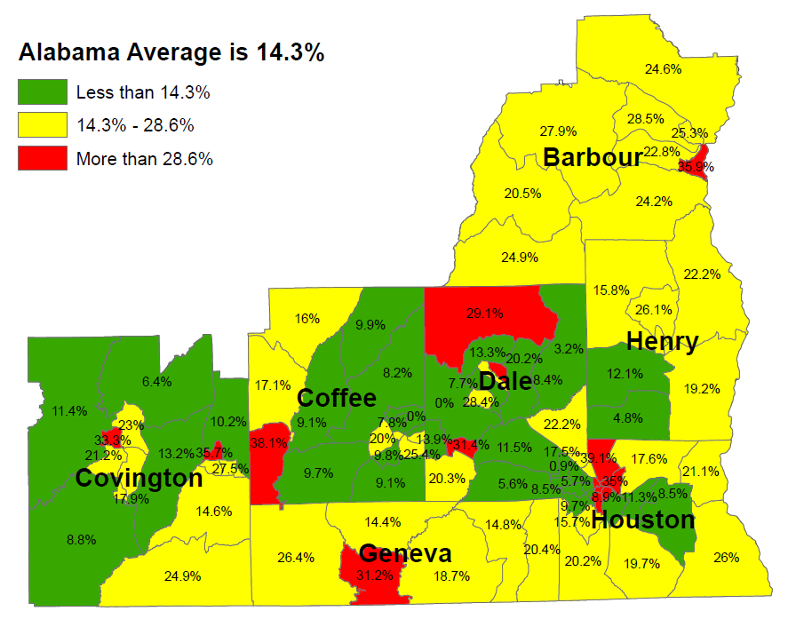
Federal Poverty Level Women Age 35-64
Census Tract, 2020
US Average: 10.2%

Slide 12
2023 HPV Vaccination Rates:
9-19 Years of Age
 | # Patients Up-to-Date Vaccine | % of Eligible
Barbour | 1,766 | 39%
Coffee | 2,260 | 33%
Covington | 1,407 | 19%
Dale | 2,910 | 27%
Geneva | 1,612 | 29%
Henry | 982 | 32%
Houston | 6,520 | 30%
State Rate: 27%
Alabama IMMPRINT Data; January 1st– September 30th 2023

Slide 13
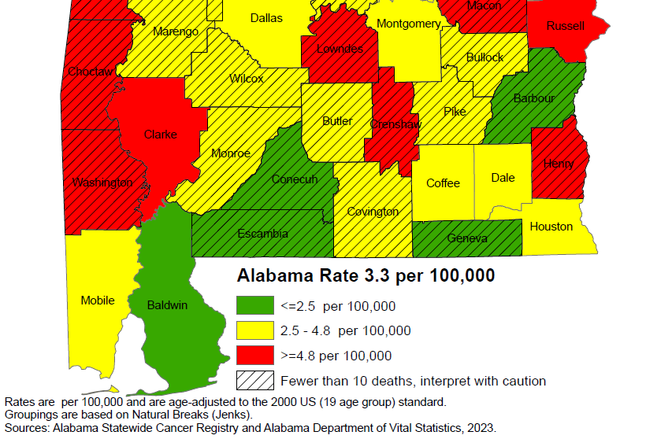
Cervical Cancer Mortality Rates:
2011-2020
National rate: 2.2 per 100,000

Slide 14
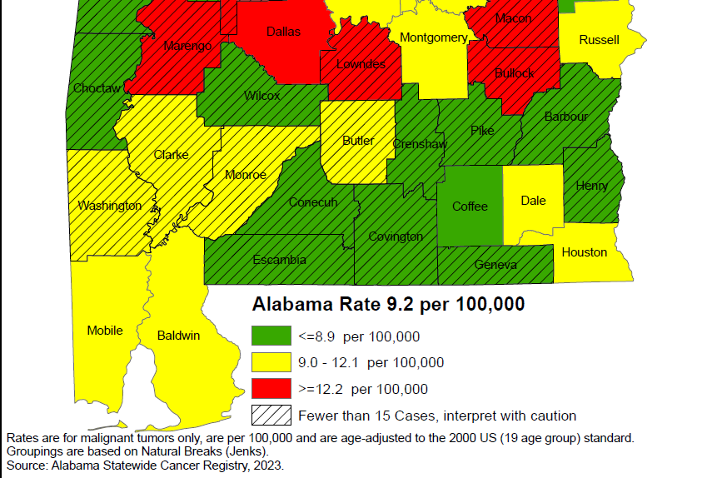
Cervical Cancer Incidence Rates:
2011-2020
National rate: 7.4 per 100,000

Slide 15
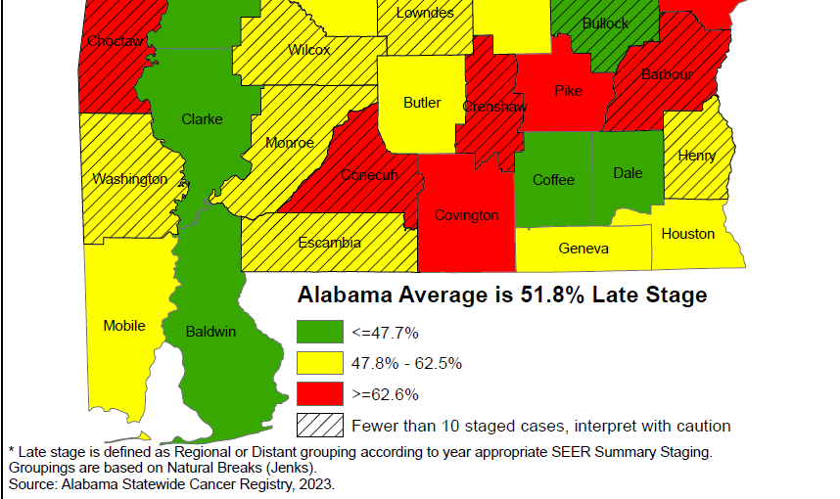
Cervical Cancer Late-Stage Cancer Rates:
2011-2020

Slide 16
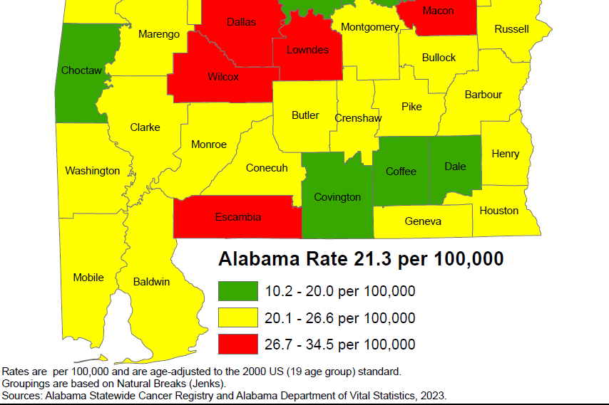
Breast Cancer Mortality Rates:
2011-2020

Slide 17
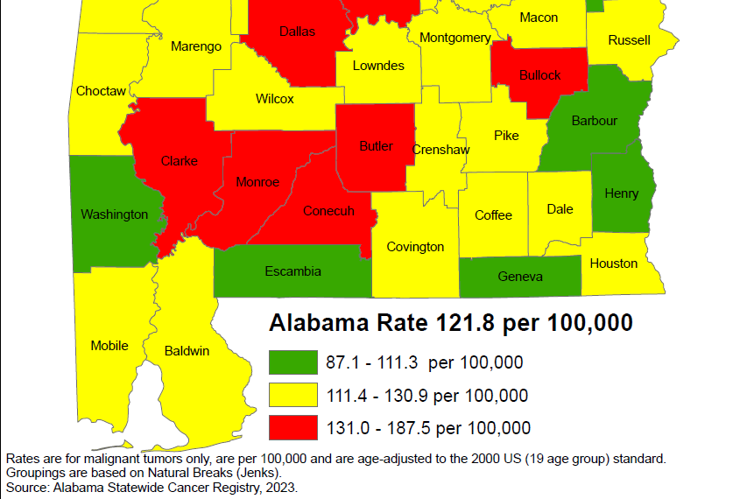
Breast Cancer Incidence Rates:
2011-2020

Slide 18
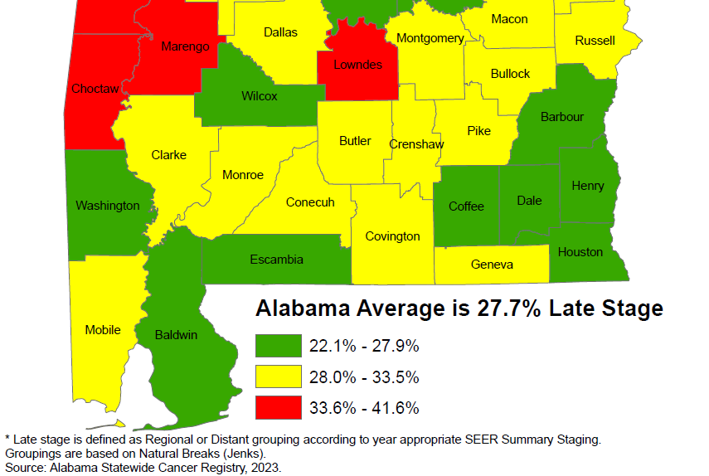
Breast Cancer Late-Stage Cancer Rates:
2011-2020

Slide 19
Alabama Breast and Cervical Cancer Early Detection Program (ABC)
Screening
Diagnostic Care
Treatment through Medicaid
No cost to the patient
Notes:
Services provided through 400+ contracted providers and county health departments.

Slide 20
ABC Eligible Women
  Age 40-64
  Income at or below 250% of Poverty Level
  No insurance
  Underinsured
  Screening for Some High-Risk Women Under Age 40
  65+ Medicare Part A Only
Notes:
-CDC provides funding to every state in the nation
-We can print up eligibility guidelines to handout if you’d like

Slide 21
How is the Program Funded?
CDC
State of Alabama
Joy to Life Foundation
Notes:
ACS

Slide 22
Who Provides the Medical Care?
400+ contracted providers statewide
  Primary Care Providers
  Gynecologists
  Radiologists
  Mammogram facilities
  Surgeons
  FQHCs
County Health Departments
Notes:
Services provided through 400+ contracted providers and county health departments.

Slide 23
Reimbursement for Providers
Medicare reimbursement rates
  Office Visit $84.67
  Pap/HPV testing $55.35
  Genotyping (16/18) $40.55
  Colposcopy w/biopsy $151.16
  LEEP (Dx & Tx) $284.81
  Mammogram $117.47
  Mammogram dx $144.94
  Ultrasound $95.33
  Biopsy $54.32
Notes:
Services provided through 400+ contracted providers and county health departments.

Slide 24
Office Visit Reimbursement
Office Visit
  Established (99213): $84.67
Pap/HPV Lab
  Lab fee (88142): $20.26
  Pap/HPV: (87624): $35.09 $140.02
  Type 16/18 (87625): $40.55
Notes:
Services provided through 400+ contracted providers and county health departments.

Slide 25
Medicaid Treatment Act
Women Under 65 diagnosed with cancer
  At/Below 250% poverty level
  No Insurance
  Under age 65
  Live in Alabama
  Legally in the U.S.
  Documentation of Breast Cancer
  Documentation of Pre- or Invasive Cervical Cancer
Notes:
Services provided through 400+ contracted providers and county health departments.

Slide 26
Medical Advisory Committee
Gary Pugh, M.D. ADPH Medical Officer Family Health Services Kaye Melnick, MSN, RN ADPH Chief Nursing Officer
Trina Simmons, NP ADPH Nurse Practitioner Director Family Health Services
Warner Huh, M.D. Gynecologic Oncology University of AL Birmingham O’Neil Cancer Center Donna Lynn Dyess, M.D. Breast Surgeon University of South Alabama Mitchell Cancer Institute
Jennifer Young Pierce, M.D. Gynecologic Oncology University of South Alabama Mitchell Cancer Institute
Stephen Varner, M.D. Obstetrics/Gynecology University of South Alabama

Slide 27
ABC Regional Data:
Barbour County
Coffee County
Covington County
Dale County
Geneva County
Henry County
Houston County

Slide 28
Women Screened by ABCCEDP
Alabama 2018 - 2022
Total Screened
Screened for Breast
Screened for Cervical
62,621 women ABC Eligible
Eligible: Women who have no insurance and with an income of <= 250% of federal poverty level and 40-64 of age

Slide 29
Cervical Cancer Screening
2018 -2022
16% of State
Notes:
2018: 742 2019: 931 2020: 570 2021: 721 2022: 799 Avg: 798…..16% of State

Slide 30
Cervical Cancer & Pre-Cancer Detected
2018 - 2022
 |  | 2018 | 2019 | 2020 | 2021 | 2022
Houston | Cancer | 0 | 0 | 0 | 0 | 0
 | Pre-Cancer | 11 | 18 | 8 | 25 | 14
Coffee | Cancer | 0 | 0 | 0 | 0 | 0
 | Pre-Cancer | 11 | 5 | 3 | 8 | 11
Dale | Cancer | 0 | 0 | 0 | 0 | 0
 | Pre-Cancer | 0 | 3 | 2 | 4 | 1
Geneva | Cancer | 0 | 0 | 0 | 0 | 0
 | Pre-Cancer | 4 | 4 | 3 | 1 | 6
Barbour | Cancer | 0 | 0 | 0 | 0 | 1
 | Pre-Cancer | 1 | 8 | 2 | 1 | 2
Covington | Cancer | 0 | 0 | 0 | 0 | 0
 | Pre-Cancer | 3 | 2 | 1 | 0 | 2
Henry | Cancer | 0 | 0 | 0 | 0 | 0
 | Pre-Cancer | 0 | 0 | 0 | 0 | 1
Alabama | Cancer | 12 | 12 | 6 | 6 | 6
 | Pre-Cancer | 250 | 447 | 409 | 319 | 488
 | % Cancer | 0% | 0% | 0% | 0% | 17%
 | % Pre-Cancer | 12% | 9% | 5% | 12% | 8%

Slide 31
Number of Colposcopies in Alabama: 2022
Houston
Flowers Pathology Group | 3
Southeast Health | 2
Houston County Health Dept | 1
Jonathan L Skinner, LLC | 1
Obstetrics and Gynecology of Dothan | 29
Flowers Hospital | 4
Women's Medical Center PC | 233
Women's Medical Center, P.C. | 7
Coffee
Coffee County Health Dept | 18
Enterprise Clinic, LLC | 11
Enterprise Women's Center | 145
Obstetrics and Gynecology of Dothan | 8
Medical Ctr Enterprise | 7
Sawyer Surgery Clinic, LLC | 2
Geneva
David H Arnold, MD | 1
Geneva County Health Dept | 1
John F Simmons, MD, PC | 1
Dale
Obstetrics and Gynecology of Dothan | 2
Alabama: 762

Slide 32
Breast Cancer Screening
2018 -2022
Notes:
2018: 192 2019:189 2020: 110 2021: 120 2022: 134 Avg: 607…..7% of state

Slide 33
Breast Cancer Cases Detected
2018-2022
 | 2018 | 2019 | 2020 | 2021 | 2022
Houston | 1 | 3 | 4 | 3 | 2
Coffee | 2 | 3 | 1 | 0 | 4
Dale | 1 | 0 | 1 | 0 | 1
Geneva | 2 | 0 | 1 | 2 | 0
Barbour | 0 | 0 | 0 | 2 | 1
Covington | 0 | 1 | 0 | 1 | 3
Henry | 1 | 1 | 1 | 2 | 1
Alabama | 108 | 110 | 97 | 100 | 78
 | 6% | 7% | 8% | 10% | 15%

Slide 34
Alabama Department of Public Health and Colposcopies
Nurse Practitioners (NP) certified for colposcopy
NPs supported by Medical Officer for Family Health Services
One NP per six Districts
Travel to health departments within Districts to provide colposcopy statewide
823+ performed this FY (Last FY 23)
72% Show rate
24% High grade result

Slide 35
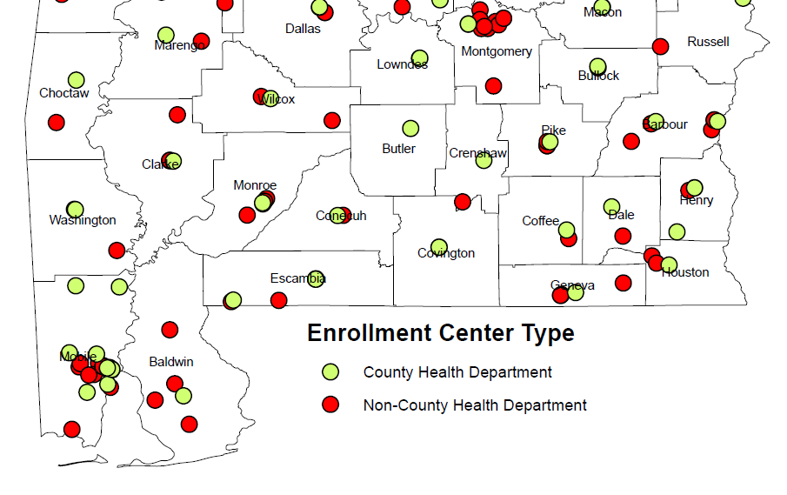
ABC Enrolling Providers

Slide 36
ABC Enrolling Providers
Barbour CHD-Eufaula
SARHA – Eufaula Family HC
SARHA – Clayton Family HC
Coffee CHD
Enterprise Women’s Center
SARHA – Children’s Center
Covington CHD
Dale CHD
SARHA – Newton Family HC
Geneva CHD
SARHA – Geneva Family HC
SARHA – Slocomb Family HC
Henry CHD
Houston CHD
SARHA – Dothan Family HC
Women’s Medical Center

Slide 37
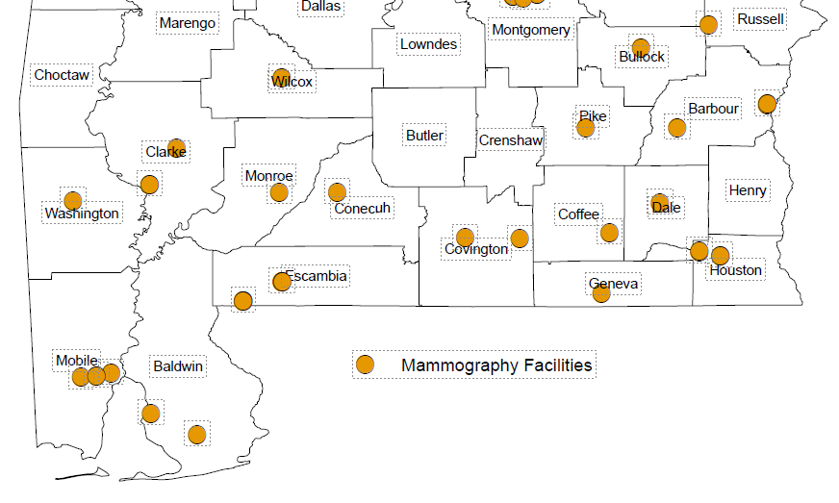
ABC Mammogram Providers

Slide 38
ABC Mammogram Providers
MCBH, LLC - Medical Center Barbour (Barbour)
Medical Ctr Enterprise (Coffee)
Andalusia Health (Covington)
Mizell Memorial Hospital (Covington)
Dale Medical Center (Dale)
Wiregrass Medical Center (Geneva)
Southeast Health (Houston)
Flowers Hospital (Houston)

Slide 39
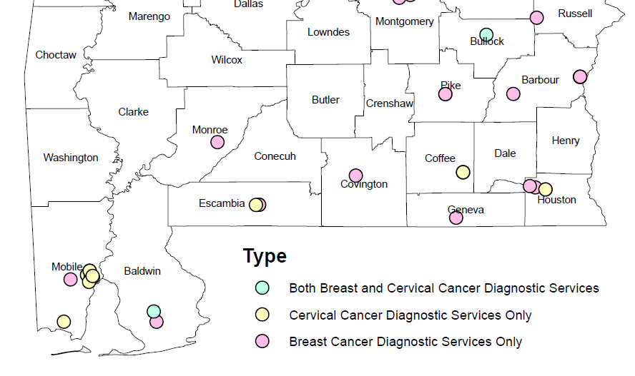
ABC Diagnostic Providers

Slide 40
ABC Diagnostic Providers
Medical Center Barbour
Dothan Anesthesiology Associates
South Alabama Diagnostic Imaging
Radiology Associates of Dothan
Medical Center Enterprise
Wiregrass Medical Center
Dale Medical Center
Southeast Health
Southeast Surgical Associates
Wiregrass Surgical Associates
Andalusia Health
Mizell Memorial Hospital
Flowers Hospital
Flowers Pathology Group
Medical Center Barbour General Surgery
Medical Center Enterprise Medical Group Surgery
Dr. Dale Mitchum, Inc.
Randall W. Nichols, MD, PC
Jonathan L. Skinner, LLC
Enterprise Women's Center
Women's Medical Center, P.C.

Slide 41
Contact Information
ABC Hotline:
https://www.alabamapublichealth.gov/bandc/
ABC Medicaid Treatment
Kelli Hardy
334-206-2976
Kelli.Hardy@adph.state.al.us
Contracts/More Information:
Nancy Wright
334-206-5851
Nancy.wright@adph.state.al.us
Notes:
Dr. Pierce, HPV Impact on Cervical Cancer
Become ABC Provider
Join Operation WIPEOUT: Vaccine, screening, and Appr FU

Slide 42
Please complete the Evaluation in your packet or through the link in the Zoom Chat
Thank you for Attending!

