Slide 1
EKGs for AEMTs
For interfacility Transfers

Slide 2
Objectives
By the end of this lesson, students will be able to:
Recognize 6 core rhythms relevant to BLS focused and limited ALS care
Interpret what the rhythm means for cardiac output
Identify when advanced ALS care is needed
Perform protocol-appropriate interventions:
High-quality CPR
Defibrillation when indicated
IV/IO access
Fluids
Epinephrine IV in cardiac arrest (Alabama protocols)
You are not becoming cardiologists today, you’re becoming a danger spotter

Slide 3
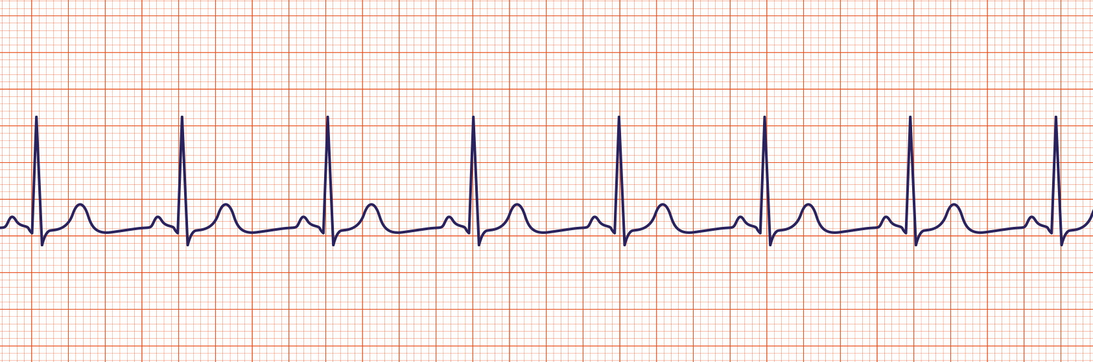
Why EKGs Matter for AEMTs
What will kill your patient today?
Rhythm = electrical activity
Electrical activity ≠ effective perfusion

Slide 4

Your Role as an AEMT
You are not diagnosing disease
You are identifying lethal rhythms
Your job is to:
Start CPR
Put them on the AED
Manage basic airway
Get access
Push epi ( as applicable)
Call additional ALS early

Slide 5
Vital Signs Matter
A rhythm is dangerous if it affects:
Perfusion
Mental status
Blood pressure
Pulse quality
No pulse = Cardiac Arrest
Cardiac Arrest = CPR first, Rhythm second
The Monitor confirms, not decides

Slide 6
4 Lead Placement
Ideally, the limb leads should go on the limbs.
Alternative placement for monitoring
RA (White): Right upper chest
LA (Black): Left upper chest
RL (Green): Right lower chest or abdomen
LL (Red): Left lower chest or abdomen
Limb leads may be placed on the torso , keep them symmetrical
Key Teaching Points
Clean, dry skin (shave if needed)
Avoid bony areas and muscle mass
Don’t mix limb heights (no shoulder + abdomen combos)
Poor placement = artifact, fake rhythms, bad decisions

Slide 7
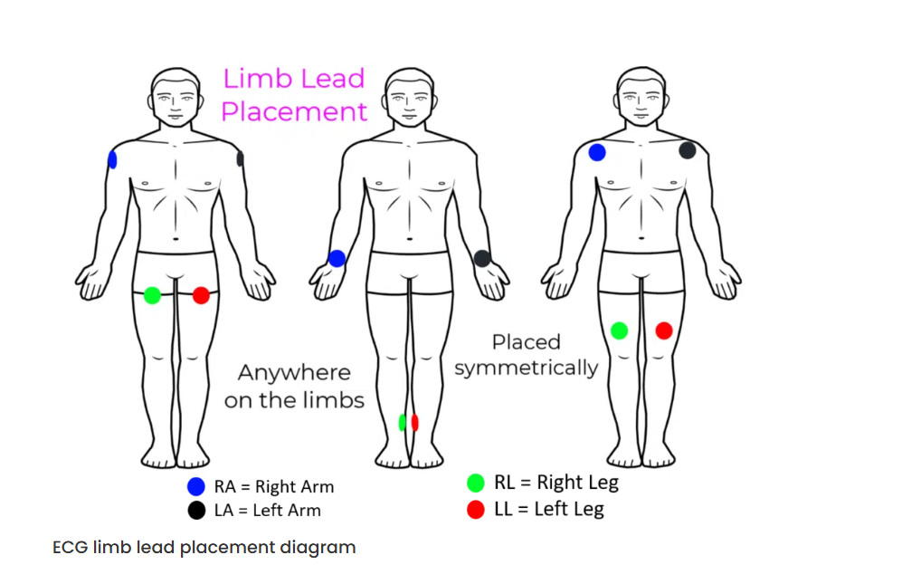
Crooked leads make crooked rhythms

Slide 8
12- Lead Placement
Torso placement acceptable inLimb Leads (Same as 4-Lead)
RA, LA, RL, LL placed symmetrically
prehospital setting for monitoring
Precordial (Chest) Leads
V1: 4th intercostal space, right sternal border
V2: 4th intercostal space, left sternal border
V4: 5th intercostal space, mid-clavicular line
V3: Between V2 and V4
V5: Anterior axillary line, level with V4
V6: Mid-axillary line, level with V4
Chest leads go on bare, clean skin
Move breast tissue, not leads
Incorrect V1/V2 placement is the #1 12-lead error

Slide 9
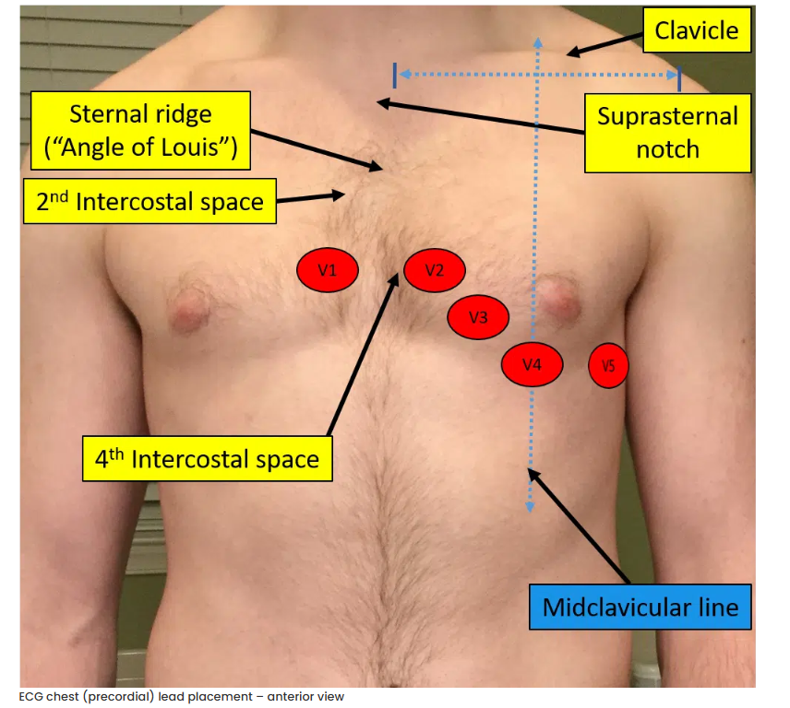
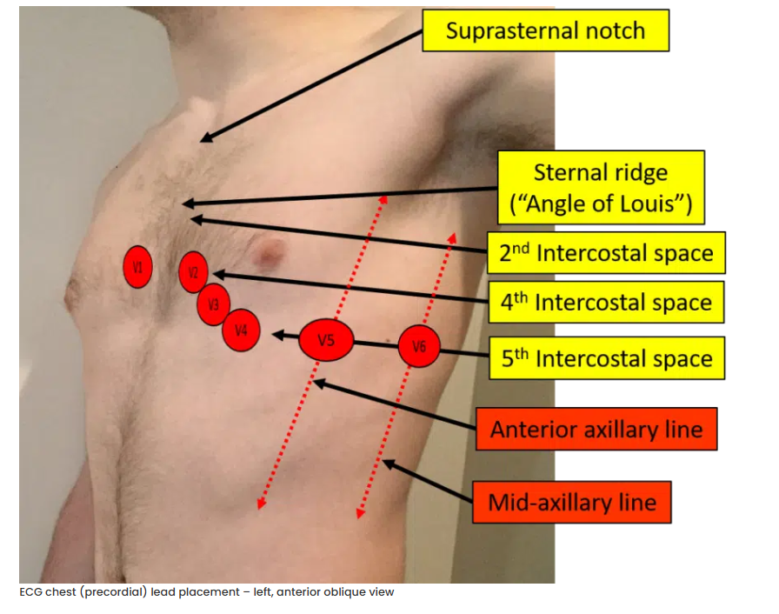
12 Lead placement

Slide 10
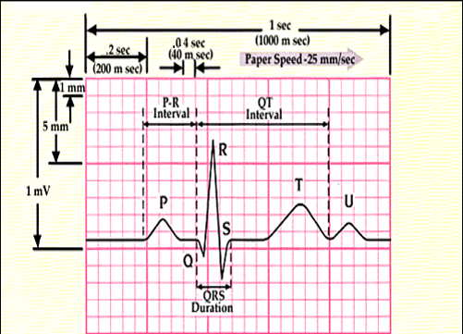
The Absolute Basics of an EKG Strip
Paper speed: 25 mm/sec
One large box = 0.2 sec
One little box = 0.04 sec
P wave
QRS Complex
T wave
Notes:
The P wave corresponds to electrical impulse traveling through the atria. This is synonymous with atrial depolarization and usually corresponds with atrial contraction.
The QRS complex corresponds to the depolarization of the left and right ventricles. It generally corresponds to the contraction of the ventricles.
The T wave corresponds to a repolarization of the ventricles.

Slide 11
What you actually look at:
Rate (slow / normal / fast)
Rhythm regularity (organized vs chaotic)
P waves (Present or absent)
QRS width (narrow vs wide)

Slide 12
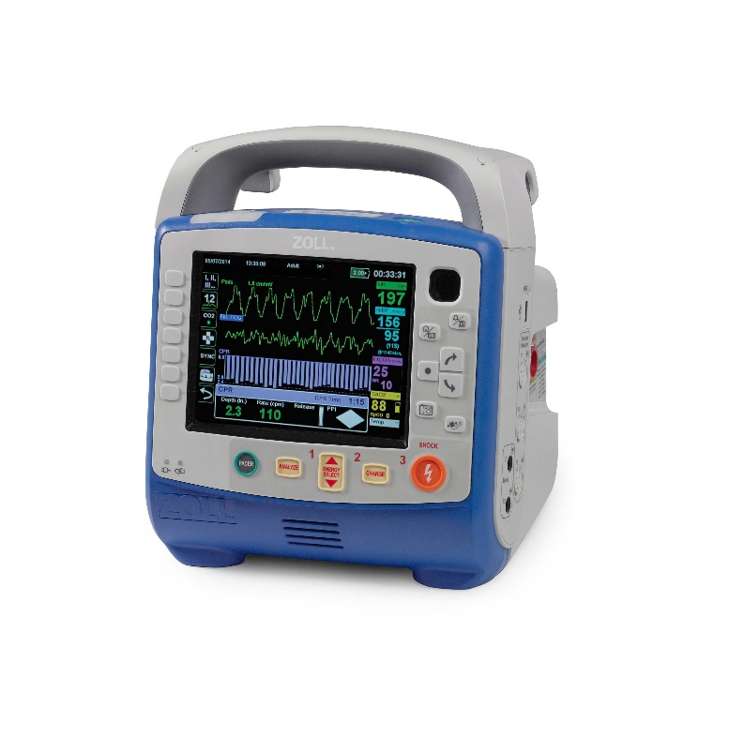
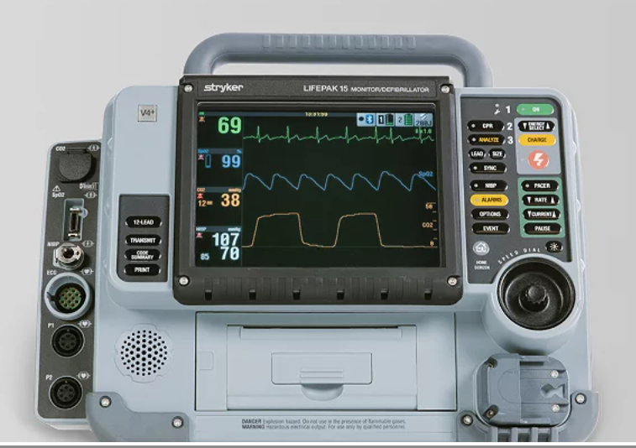
Rhythm Categories
Benign / Expected
Compensatory
Lethal

Slide 13
Normal Sinus Rhythm ( NSR)
What it is:
What to do:
Rate: 60–100
Regular
P before every QRS
Narrow QRS
This rhythm is not your emergency
Look elsewhere for patient issues

Slide 14
Normal Sinus Rhythm ( NSR)
This rhythm is not your emergency.
Unless there’s no pulse.

Slide 15
Sinus Bradycardia
What it is:
What to do :
Rate: <60
Regular
P waves present
Organized
Assess perfusion
Oxygen
IV access if unstable
Fluids if hypotensive
Call for advanced ALS

Slide 16
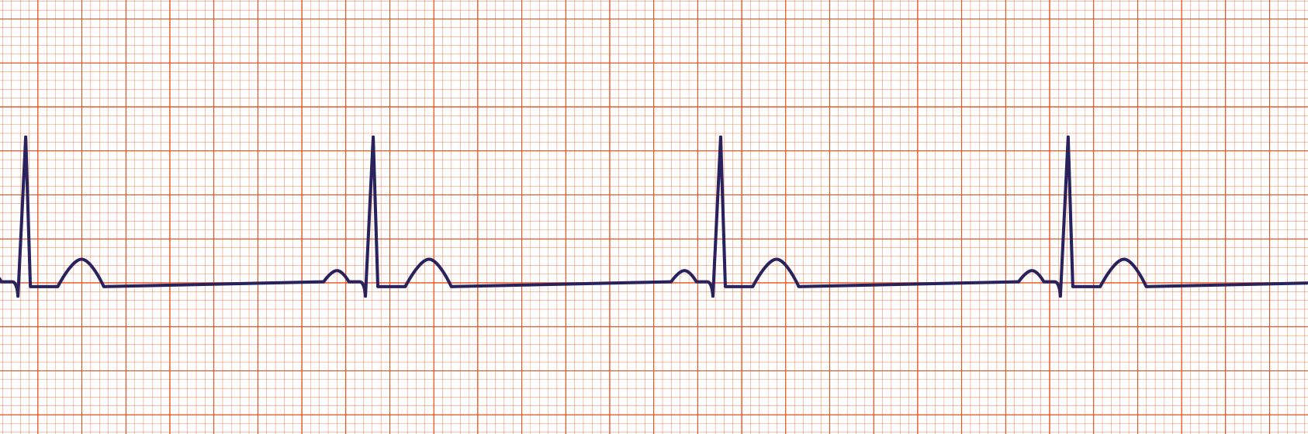
Sinus Bradycardia
Stable vs Unstable

Slide 17
Sinus Tachycardia
What it is:
What to do:
Rate >100
Regular
P waves present
Body is asking for help
Pain
Hypovolemia
Fever
Anxiety
Treat the cause
Fluids
Oxygen
Pain control (if allowed)

Slide 18
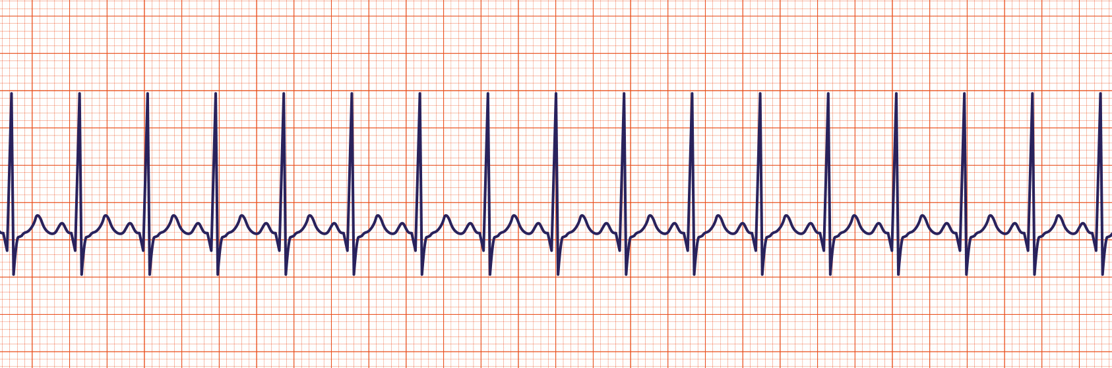
Sinus Tachycardia

Slide 19
Ventricular Fibrillation ( V-Fib)
What it is:
What to do:
CPR immediately
Defibrillate ASAP via AED
Manage Airway via BVM
Then, ONLY if doesn’t interfere with compressions
Supraglottic Airway
IV/IO
Epinephrine IV
Chaotic
No organized QRS
No pulse
Shockable

Slide 20
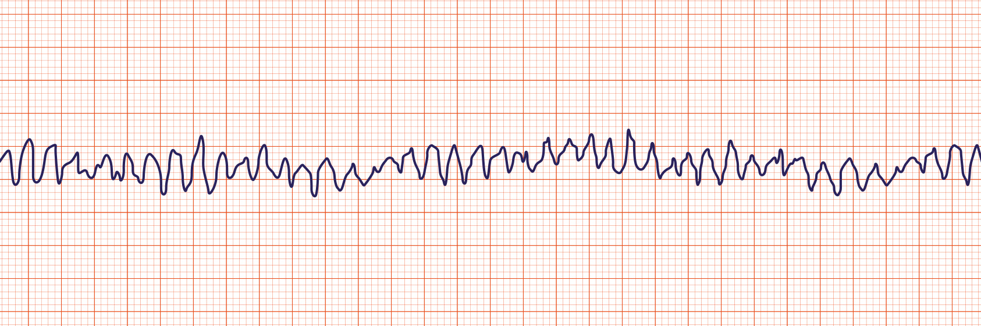
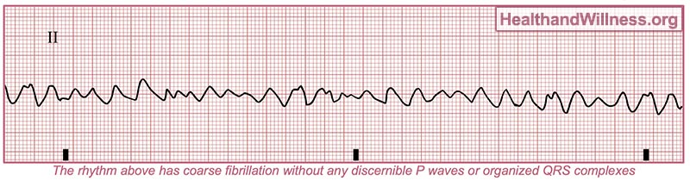
Ventricular Fibrillation ( V-Fib)
This is a defibrillation problem

Slide 21
Ventricular Tachycardia ( V-Tach)
What it is :
What to do:
Fast
Bizarre, Wide QRS
No P wave
No T wave
Regular or slightly irregular
It depends if they have a pulse or not.

Slide 22
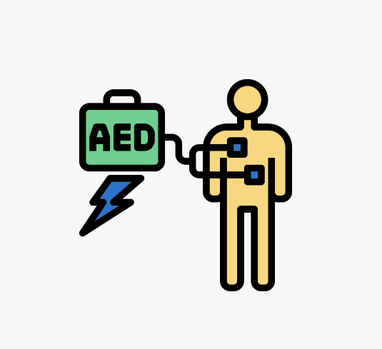

Ventricular Tachycardia ( V-Tach)
Pulseless VT
Treat exactly like VF
CPR + Defib + Epi
VT with a Pulse
Monitor
Oxygen
IV access
Rapid transport
ALS intercept

Slide 23
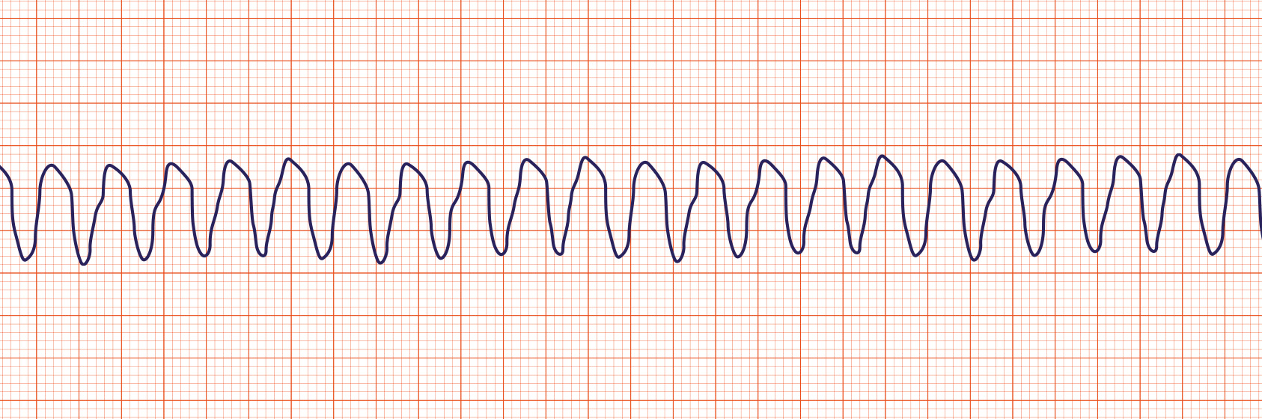
Ventricular Tachycardia ( V-Tach)

Slide 24
Asystole
What it is:
What to do:
Flat line
No electrical activity
Confirm in 2 leads
Check cables & lead connections
Non-shockable
CPR
Airway
IV/IO
Epinephrine IV
Identify Hs & Ts

Slide 25
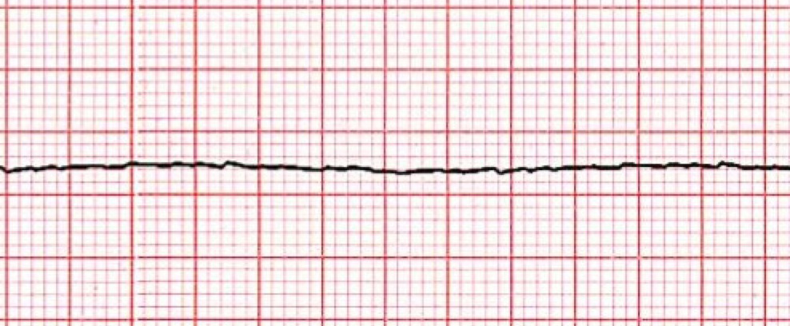
Asystole
This is not a shockable rhythm. Electricity can’t fix nothing.
If they are talking to you, It’s not asystole.

Slide 26
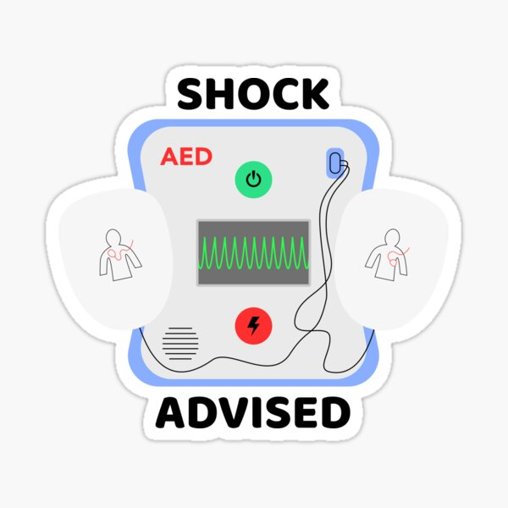
Key Information
Is there a pulse?
Yes → Supportive care + Transport
No → CPR
Shockable?
Yes→ AED + CPR
No → CPR + Airway + Epi
Always Check for a pulse before switching to AED mode on the monitor.
VTACH can have a pulse
AED mode may shock automatically
Shocking a perfusing rhythm is a bad day for everyone.

Slide 27
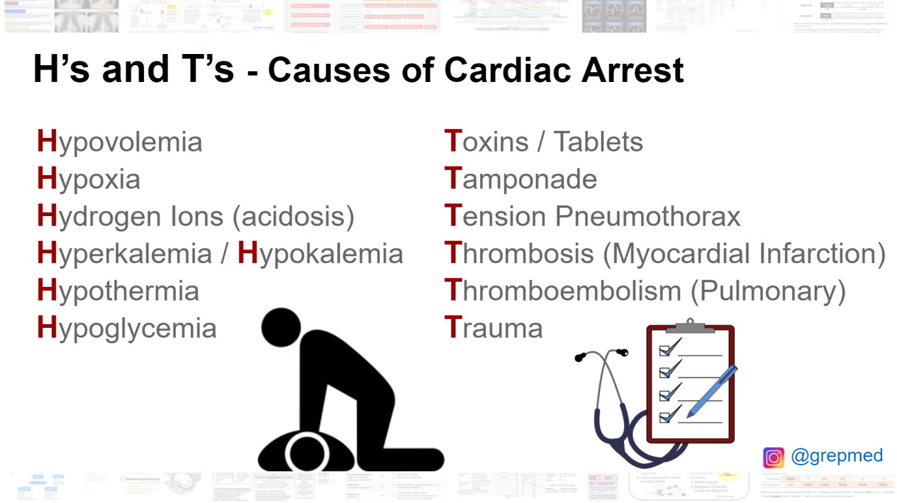
AEMT Interventions & Priorities in Cardiac Arrest
Compressions
Airway
IV vs IO
Epinephrine
Narcan
Dextrose
Fluids

Slide 28
One More Rule
If you can’t decide in 10 seconds
Check the pulse
Start CPR if absent
Call for advanced ALS
No Overthinking allowed

Slide 29
Let’s Practice!
We will decide :
What is it & what do we do first?

Slide 30
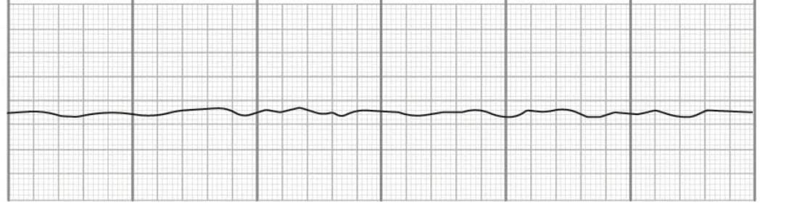
What is it?

Slide 31
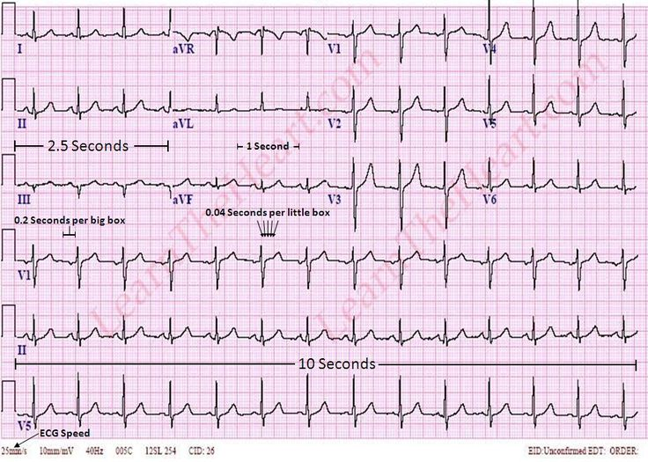
What is it?

Slide 32
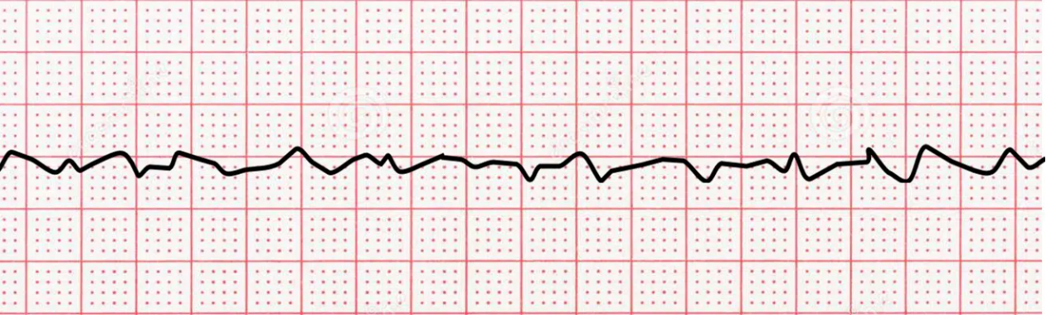
What is it?

Slide 33
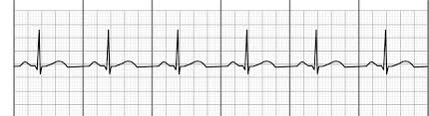
What is it?

Slide 34

What is it?

Slide 35
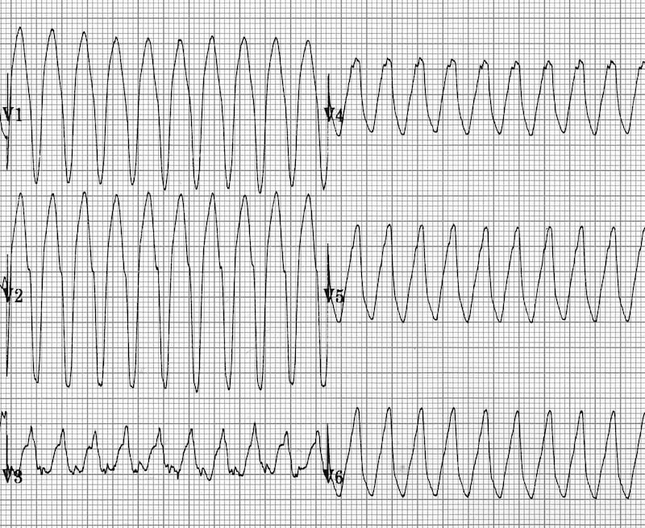
What is it?

Slide 36
What is it?

Slide 37
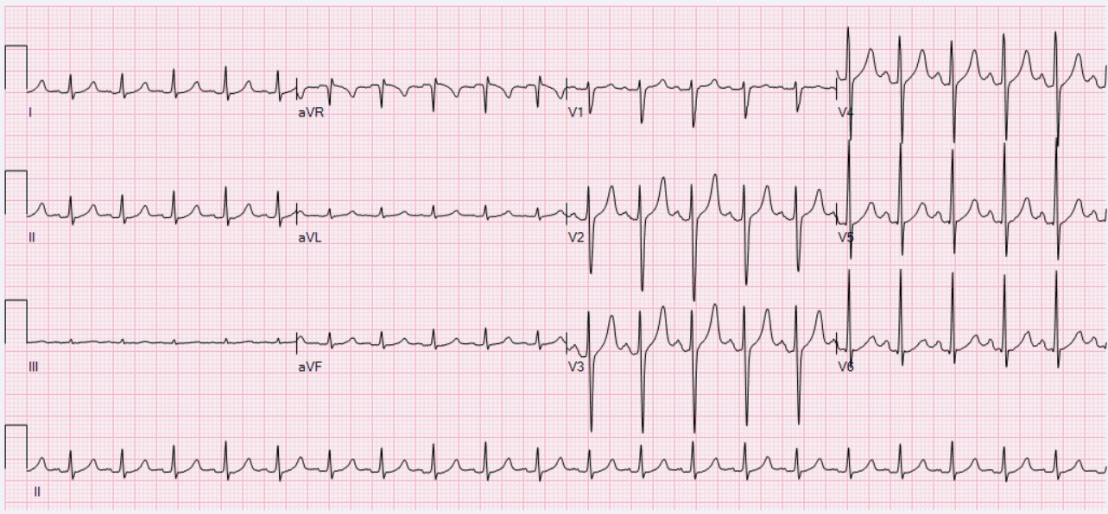
What is it?

Slide 38
What is it?

Slide 39
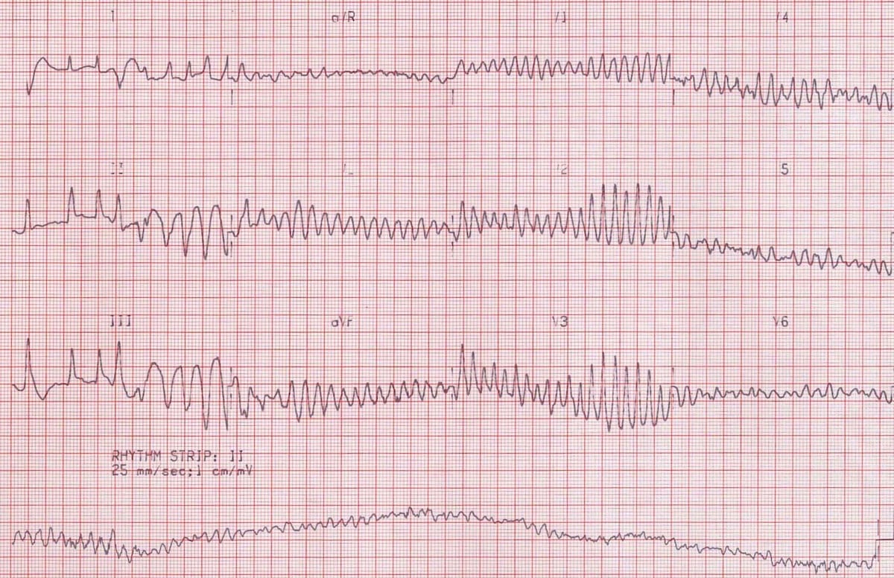
What is it?

Slide 40
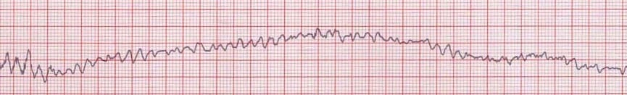
What is it?

Slide 41
What is it?

Slide 42
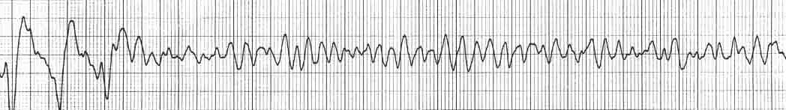
What is it?

Slide 43
What is it?

Slide 44
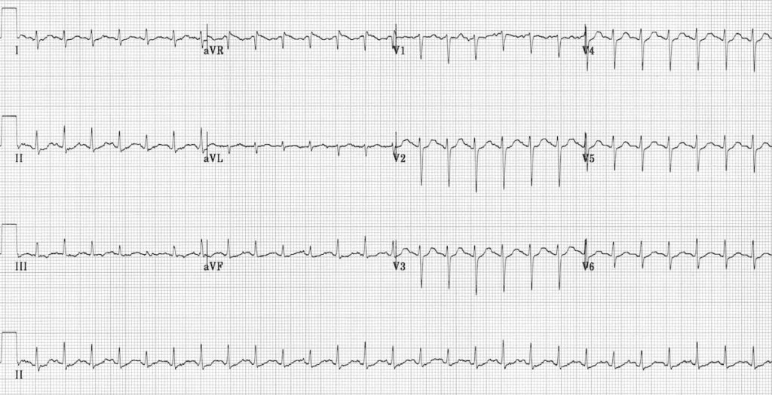
What is it?

Slide 45
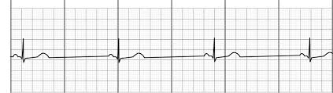
What is it?

Slide 46
What is it?

Slide 47
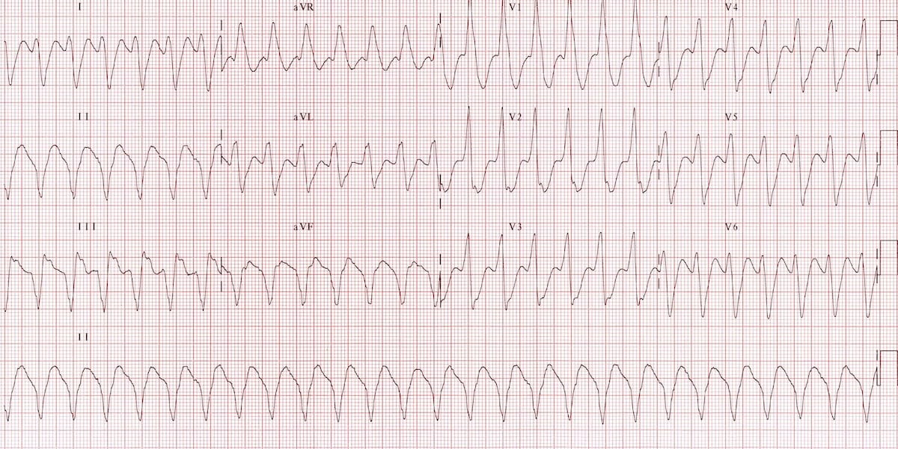
What is it?

Slide 48
What is it?

Slide 49
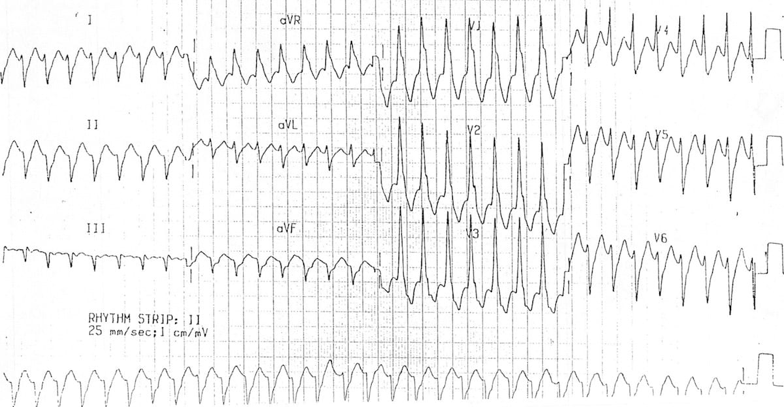
What is it?

Slide 50
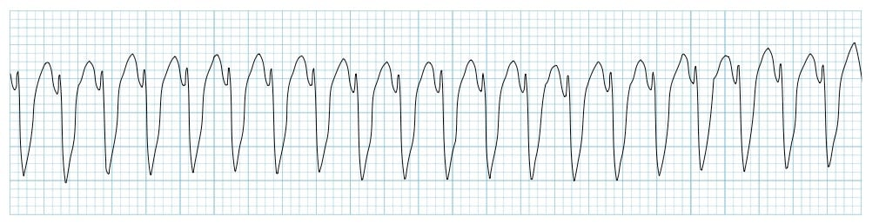
What is it?

Slide 51
What is it?

Slide 52
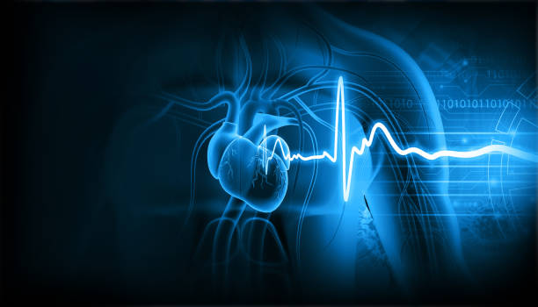
Any questions?

